Slide 1
Containers for Windows Developers
Over the last few years, Docker has popularized Linux containers, but Windows developers have been left out in the cold. This changes with Windows Server 2016. At this session we’ll cover the basics of the new Windows Server container model and how to develop applications/services that can take advantage of this exciting new advancement, for cloud, for on-prem, and for the future.

Slide 2
Containers for Windows Developers
Michael S. Collier
CodeMash 2017
Thursday, January 12th @ 11:45am in Indigo Bay
#CodeMash
Notes:
Understand the options available and have a good baseline for making choices for your solutions.

Slide 3
Michael S. Collier
Senior Software Development Engineer,
DX TED – Global Commercial ISV
michael.collier@microsoft.com
@MichaelCollier
www.MichaelSCollier.com

Slide 4
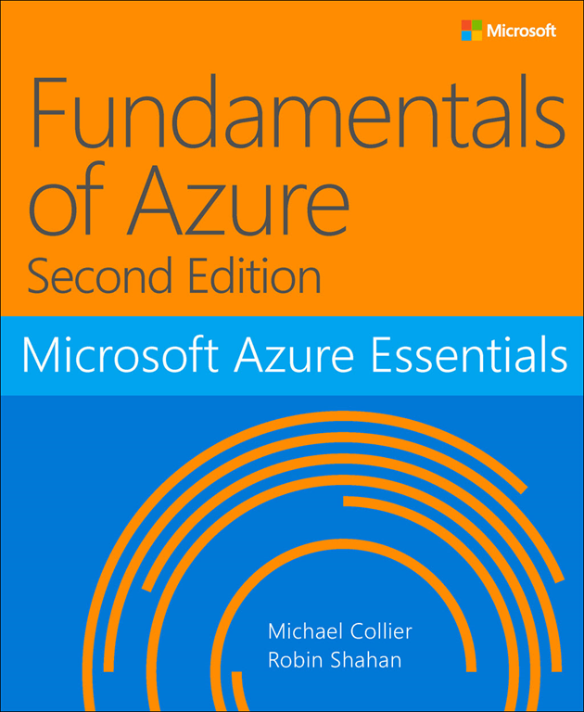
http://aka.ms/FundAzure2e

Slide 5

Setting Expectations
Focus on Windows Containers
Windows Server 2016 & Windows 10
Not orchestration of multiple containers
Not going to make you an expert
Leave your fear behind!
Big topic!
POV of a long-time Windows guy
Don’t mock me – I like a good GUI. N/A. Real power in cmd.
If you already know containers on Linux…
Notes:
We’re going to focus on Windows Server 2016
Over the last few years, Docker has popularized Linux containers, but Windows developers have been left out in the cold This changes with Windows Server 2016. At this session we'll cover the basics of the new Windows Server container model and how to develop applications/services that can take advantage of this exciting new advancement, for cloud, for on-prem, and for the future.
We’re not going to make you an expert
It’s a big topic and more than can be covered in an hour. And its also still evolving (Windows containers are still in preview). So my hope is that when you leave this session, you may still be afraid of preview software, but hopefully are terrified of containers anymore.
Windows guy . . .
I like GUIs . . . Most of the time. Makes me feel all warm and fuzzy. Blinky cursors mock me!
Fully understand and embrace the cmd line and config files, and blinky cursors, once I understand what I’m doing.
If you already know containers on Linux…
If you’re familiar with containers on Linux, you can check email for the next 10-15 minutes, pay attention for 5-10 minutes (when I talk about Windows Server 2016), then go find another session if you like. ☺
image from: https://thetechbench.wordpress.com/category/client-expectations/

Slide 6
Docker ≠ Containers
Notes:
Docker is NOT containers.
Container technology has been around forever, Docker just popularized a common container image format/engine that has grown into an ecosystem.

Slide 7
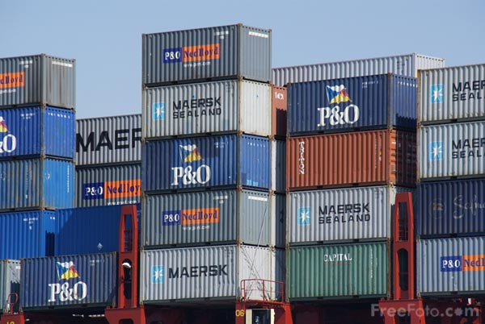
History Lesson
1982
2000
2002
Bill Joy adds ‘chroot’ to Unix
“jails” in FreeBSD
Security as design point
Solaris Zones
Operating system virtualization
2010
dotCloud – PaaS provider
OS container technology
March 2013
Docker open source project
Started in Linux in early 2000’s
Present, but not very usable
Docker made them popular in June 2014
1.0 release; Easier to use
Image Source: http://www.freefoto.com/preview/13-73-32/Southampton-Container-Terminal
Notes:
started with 'chroot'
virtualizes part of the file system
ability to break out of the file system by going to the parent (cd ..)
jails
Solaris / FreeBSD
confine the app as to not destroy the system
apps couldn't see each other
Sun Microsystems
Solaris zone
2002
complete operating system virtualization
'container' <-- term from Sun marketing team
sell a large machine
consolidate many apps to a single machine
limitations
needed to run the same OS kernel
bad if need to consolidate Windows boxes (OS virtualization)
need hardware-level virtualization
hardware-level virtualization became de facto in the cloud
hypervisor
dotCloud - a PaaS provider
started OS containers
open sourced Docker
sold off assets and renamed as Docker
Linux Containers (LXC) are an operating-system-level virtualization method for running multiple isolated Linux systems (containers) on a single control host (LXC host). It does not provide a virtual machine, but rather provides a virtual environment that has its own CPU, memory, block I/O, network, etc. space and the resource control mechanism.
Became popular around 2013
Docker provides an additional layer of abstraction and automation of operating-system-level virtualization on Linux. Docker uses the resource isolation features of the Linux kernel such as cgroups and kernel namespaces, and a union-capable file system such as aufs and others to allow independent "containers" to run within a single Linux instance, avoiding the overhead of starting and maintaining virtual machines.
Image Source: http://www.freefoto.com/preview/13-73-32/Southampton-Container-Terminal

Slide 8
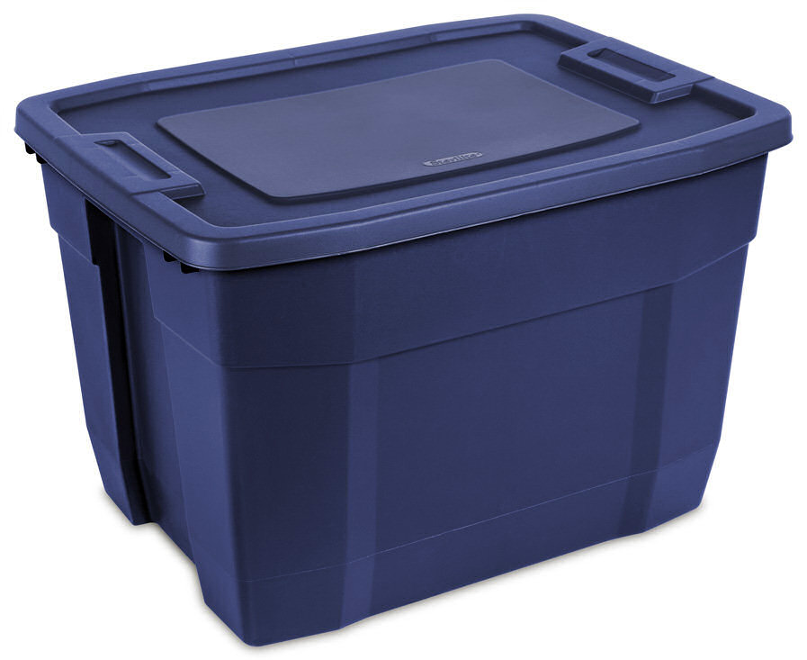
Docker Additions to Containers
Was the first “engine”
simple interface to create/manage containers
Docker Container Image
layer, upon layer, upon layer, …
Namespaces, Union file system (UnionFS), & control groups
Immutability
Image Repositories
hub.docker.com
See https://docs.docker.com/engine/understanding-docker/ for more on how Docker works.
Image Source: http://www.sterilite.com/SelectProduct.html?id=772&picture=1&tab=Uses&ProductCategory=181&section=1
Notes:
Engine
The first key thing Docker did was create a simplified interface. While containers were already there, they were difficult to use. I’ve been told (I had turned my focus away from Linux several years earlier) that before Docker you nearly needed an PHD to work affectively with containers.
Images
Docker introduced the notion of a “composable”, layered image. This allowed you to reuse other images to compose an image specific to your needs. Its follows a “configuration as code” approach using a simple syntax.
from: https://wiki.archlinux.org/index.php/Linux_Containers
Namespaces – provide the isolated workspace called the “container”. Docker creates a set of namespaces for the container.
UnionFS – file systems that operate by create layers; Docker uses as building block for containers. Allows files and directories of separate file systems, known as branches, to be transparently overlaid, forming a single coherent file system. Changes impact only designated layer; others remain intact. Only need to distribute the updated layer. One of the reasons Docker is so lightweight.
Control groups (cgroups) – limits an application to a specific set of resources. Share available hardware resources to containers; enforce limits & constraints.
Repositories
A library of reusable images. Repositories can be public (like http://hub.docker.com) or private. You’ll likely use a combination of repositories for your company workloads. i.e. a private repository for your organization’s images which builds upon images pulled from public repositories. This builds a social aspect to sharing and collaborating on Docker images . . . much like Git/GitHub.
Image Source: http://www.sterilite.com/SelectProduct.html?id=772&picture=1&tab=Uses&ProductCategory=181&section=1

Slide 9
Docker Architecture
Clients
Hosts
Registries
Docker Image
Template for creating Docker containers.
Tags for specific version, or “latest”.
Docker Container
Like a tiny VM created from instructions within the image.
Docker Client
Command-line utility using Docker API to communicate with Docker daemon.
Docker Host
Physical or virtual machine running Docker daemon; contains cached images & runnable containers.
Docker Registry
Repository of Docker images to create containers.
localhost
Docker Hub
daemon
repository 1
docker build
docker pull
docker run
container 1
image 1
image 1
container 2
image 2
image 2
container 2a
repository 2
image 3
image 4
remote host
daemon
Private Registry
container 3
image 3
repository 1
container 4
image 4
container 5
image 5
image 5
Image 6
Source: https://dzone.com/refcardz/getting-started-with-docker-1
Notes:
https://dzone.com/refcardz/getting-started-with-docker-1
Docker client interface and APIs are the same on Windows and Linux!! Tools used to remotely manage Docker on Linux can also be used to manage Docker on Windows.
Daemon ➔ (“de-mon”)

Slide 10
Immutability & Layers
r/w
ADD
650e08a9c2d4
650e08a9c2d4
docker commit
CMD
650e08a9c2d4
……
……
powershell
379bd603bf53
docker run
49b6aced7ad3
49b6aced7ad3
powershell
249081ecf5ee
microsoft/mssql-server-windows
mcollier-on.azurecr.io/samples/sql:v1
WORKDIR
307f05c5da18
COPY
507f02c8eb14
ENV attach_dbs
49b6aced7ad3
ENV ACCEPT_EULA
307f05c5da18
docker run
r/w
650e08a9c2d4
ENV sa_password
507f02c8eb14
MAINTAINER
49b6aced7ad3
……
microsoft/mssql-server-windows
49b6aced7ad3
microsoft/mssql-server-windows
Notes:
Image is read-only
When ran, a writable container layer is added. Each container has a different layer.
If the container is deleted, the writable layer is gone
Persist changes to the writable layer by committing before deleting. Creates a new image, which is distinct from the original.
http://www.infoworld.com/article/3077875/linux/containers-101-docker-fundamentals.html

Slide 11
VMs vs. Containers

Slide 12
VM vs. Container
VM == House
Secure entry / front door
Dedicated utilities (electric, water, etc.)
More families, more houses are built
Notes:
You may have heard this analogy before, but I’ll go through it quickly because I think it is a good one and still worth repeating.

Slide 13
VM vs. Container
Container == Apartment Complex
Doorman to orchestrate entry & exit
Secure entry / front door to each apartment
Shared utilities (electric, water, etc.)
Large building/infrastructure pre-built to handle many families

Slide 14
The Case for VMs
Network and Identity
DHCP; Domain controllers
Security
True isolation across processes (or Hyper-V mode)
Hardware
Printing and GPU
Active Directory dependency
Group policy
Mail
Desktop apps
Remote desktop and VDI
Notes:
Security - The only way to have true isolation across processes is to use a VM or a Hyper-V container. If an exploit to the Linux C-groups implementation emerged (or the Windows Container implementation) then it would be possible to compromise across container boundaries. If you’re running in a VM you have a separate kernel and memory mapped virtually by the Hypervisor which prevents these types of attacks.

Slide 15
Windows Server 2016

Slide 16
Windows Server 2016 Container Hosts
Nano Server
Server Core
Highly Compatible
Highly Optimized
Born in the cloud applications
Traditional Applications

Slide 17
Nano Server: just enough OS
Optimized for next-gen distributed applications
Higher density, and reduced attack surface and servicing requirements
Next-gen distributed app frameworks
Interoperate with existing server applications
Third-party applications
RDS experience
Traditional VM workloads
Containers and next-gen applications
Full GUI
Specialized workloads
Server Core
Lower maintenance server environment
Nano Server
Just enough OS
Content © Microsoft
Notes:
Nano Server centers around the concept of “just enough OS”. Its been striped of as many dependencies as possible and optimized for next-gen applications and containers.
#click (show first column)
This gives you higher density and fewer patches while also reducing the attack footprint by removing unnecessary services. A secure, minimal environment for running applications. Its about 400mb on disk with no extra roles/features added. It is 64bit only.
#click (show second column)
Further up “the stack” is Server Core where you can run traditional workloads or container based applications.
#click (show third column)
And finally is the “full GUI” server with a desktop experience where you can host applications that require a GUI experience or perhaps need to host remote desktop services.

Slide 18
High Level Architecture
}
Docker Universal Control Plane
Container
Development and
Management Toolset
Docker Client
Docker PowerShell
Docker Compose
Docker Registry
Docker Swarm
Docker Engine
Operating System
Container Runtime
Notes:
Container is an OS construct. Container lives in the OS. Same for Windows and Linux.
Docker Engine talks to the OS. Linux it is cgroups and namespace providers. Windows it is the host compute service. Calls the right system APIs.
Toolsets to talk to the Docker Engine.
Control Plane / Orchestration engines

Slide 19
Windows Containers
Host User Mode
System Processes
Session Manager
Container Management
Local Security Authority
Docker Engine
Etc…
Windows Kernel
Notes:
One of the things that kind of interesting is that we have a couple of container runtimes. We’ll start with Windows Server Containers. These are very similar to the Linux container model. We have our Windows Kernel…
Set of system processes that you’re likely to see on any Windows server.
And then we have container management. Our compute services which is our layer of containers in the operating system. And the Docker engine.

Slide 20
Windows Containers
Host User Mode
System Processes
Session Manager
Container Management
Local Security Authority
Windows Server Container
Docker Engine
Etc…
Windows Kernel
Notes:
When we actually start a container, what we’re doing is starting up a new “user mode” and put copies of each of those system processes in.

Slide 21
Windows Containers
Host User Mode
System Processes
Session Manager
Container Management
Local Security Authority
Windows Server Container
Docker Engine
Etc…
System Processes
Windows Kernel
Notes:
When we actually start a container, what we’re doing is starting up a new “user mode” and put copies of each of those system processes in.

Slide 22
Windows Containers
Host User Mode
System Processes
Session Manager
Container Management
Local Security Authority
Windows Server Container
Docker Engine
Etc…
System Processes
Application Process(es)
Windows Kernel
Notes:
And then the application process, whatever you put on the “docker run” line. If it was an IIS web server, it would have it own w3wp process. The reason for this model is that without these processes, we couldn’t have isolation between containers. You couldn’t make your own user name as it would be shared by the host. This way its specific to the container. Now you’d think this would be somewhat heavy with all these extra processes. But we’ve actually done a great deal of optimization around memory and startup time such that we can start up a Nano Server container in about 1.15 seconds right now and our goal is to get this down to a second by the time Windows Server 2016 ships later this year. We think this is a pretty amazing startup time. We also haven’t seen much memory overhead from these processes, and they give us that high degree of isolation folks expect from containers.
Why a separate container? Security and isolation. Don’t want it to know about the host. Know about the virtualized view.

Slide 23
Windows Containers
Host User Mode
System Processes
Session Manager
Container Management
Local Security Authority
Windows Server Container
Docker Engine
Etc…
System Processes
Application Process(es)
Windows Kernel
Notes:
And of course we can have multiple of these containers running side by side. Each representing their own set of “user mode” processes. This is a fairly traditional container model, but being Microsoft, we really aren’t satisfied with being traditional. So we came up with another model.

Slide 24
Windows Containers
Host User Mode
System Processes
Session Manager
Container Management
Local Security Authority
Windows Server Container
Windows Server Container
Docker Engine
Etc…
System Processes
Application Process(es)
System Processes
Application Process(es)
Windows Kernel
Notes:
And of course we can have multiple of these containers running side by side. Each representing their own set of “user mode” processes. This is a fairly traditional container model, but being Microsoft, we really aren’t satisfied with being traditional. So we came up with another model.

Slide 25
Windows Containers
Host User Mode
System Processes
Session Manager
Container Management
Local Security Authority
Windows Server Container
Windows Server Container
Docker Engine
Etc…
System Processes
Application Process(es)
System Processes
Application Process(es)
Windows Kernel
Windows Kernel
Hyper-V Hypervisor
Notes:
Hyper-V containers differ from Server Containers in that they start with the Hyper-V Hypervisor.
This contains the Windows Kernel. Could run a different kernel than the host!
Start up a Windows Server Container inside of that.
The same set of System processes. This is a minimal set, just enough to launch.
And our compute services and Docker engine. Much like we have with a Server Container Host.

Slide 26
Windows Containers
Host User Mode
System Processes
Virtual Machine Specifically Optimized To Run a Container
Session Manager
Container Management
Local Security Authority
Windows Server Container
Windows Server Container
Docker Engine
Etc…
System Processes
Application Process(es)
System Processes
Application Process(es)
Windows Kernel
Windows Kernel
Hyper-V Hypervisor
Notes:
All this happens with a specially purposed Virtual Machine. This virtual machine has only one purpose in being, to run a container. We did this so that we get the same isolation boundaries that a traditional virtual machine has. If, unbelievably, someone were figure out some weird way to get outside of the container and mess with the kernel, they could crash themselves, but would be unable to hurt anyone else. This also means we have kernel independence, we could run different versions of the kernel. We could run the app on different versions of the operating system and all sorts of interesting things we’ll get into later.
Clone. Copy in memory. Very fast start-up.

Slide 27
Windows Containers
Host User Mode
System Processes
Hyper-V Container
Virtual Machine Specifically Optimized To Run a Container
Session Manager
Container Management
Local Security Authority
Windows Server Container
Windows Server Container
Docker Engine
Etc…
System Processes
Application Process(es)
System Processes
Application Process(es)
Windows Kernel
Windows Kernel
Hyper-V Hypervisor

Slide 28
“There are only two hard things in Computer Science: cache invalidation and naming things.”
-- Phil Karlton
http://martinfowler.com/bliki/TwoHardThings.html

Slide 29

Windows Container Isolation Modes
Host Operating System | Windows Server Container | Hyper-V Container
Windows Server 2016 with Desktop | Server Core / Nano Server | Server Core / Nano Server
Windows Server 2016 Core | Server Core / Nano Server | Server Core / Nano Server
Nano Server | Nano Server | Server Core / Nano Server
Windows 10 Pro / Enterprise | Not Available | Server Core / Nano Server
Windows Server: shared-kernel process-isolation (similar to Linux). Fast startup with minimal overhead.
Hyper-V: processes run inside a very minimal hypervisor created at startup. Better isolation; slower startup & increased resource overhead.
Container
Container Host
Nested Virtual Machine
Container
Container Host
Virtual Machine Host
Physical Server
Physical Server
Content © Microsoft
Notes:
So a couple notes on the deployment model…
With Windows Server Container, which can be run on either Windows Server 2016, Window Server 2016, or Nano Server, the container can be either Windows Server Core or Nano Server. Because Windows Server isolation mode shares the kernel, you cannot run Windows Server Containers on Windows 10. Additionally, the Build number (Major.Minor.Build.Revision) must match. If revision number is different, not technically blocked, but may not function properly under all circumstances and thus cannot be supported for production environments.
With Hyper-V containers, we support either Server Core or Nano Server. Additionally, the host can be anything we want… Nano Server, Server Core, or even Windows Server/Desktop. This is because the Hyper-V container has its own, independent copy of the kernel.
Windows client – “hyperv” is the default isolation mode
Windows server – “process” is the default isolation mode
$ docker run -d --isolation default busybox top
$ docker run -d --isolation hyperv busybox top
$ docker run -d --isolation process busybox top
https://docs.docker.com/engine/reference/commandline/run/#/specify-isolation-technology-for-container---isolation
https://docs.microsoft.com/en-us/virtualization/windowscontainers/deploy-containers/system-requirements
https://blog.docker.com/2016/09/dockerforws2016/

Slide 30




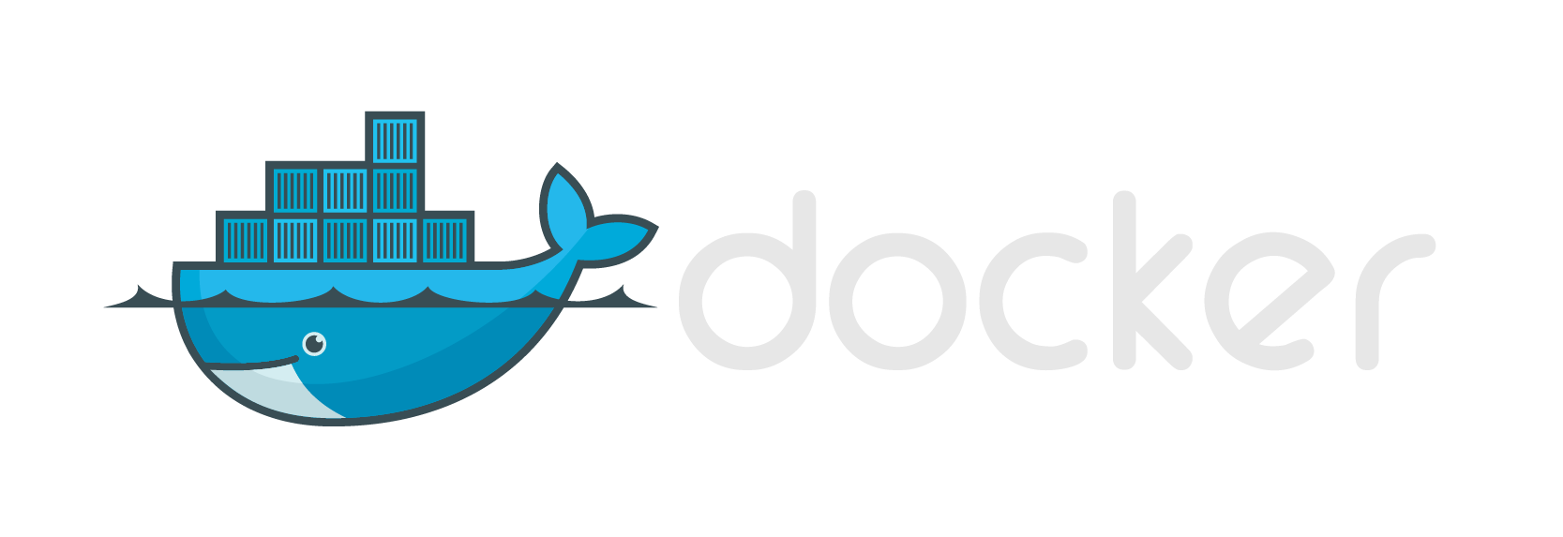




Modern App Development, Flexible Isolation
Windows Container Images
Container Run-Times
Container Management
PowerShell
Hyper-V Container
Docker
Application
Framework
Application
Framework
Others
Windows Server Container
Write once, deploy anywhere
Notes:
The power of this model is that regardless of which container isolation strategy you select, be it Server containers or Hyper-V containers
#click
You deploy the exact same container images.

Slide 31
General Guidance
Deploy-time difference
Security and Isolation
Container
Container
Container Host
Nested Virtual Machine
Container Host
Virtual Machine Host
Physical Server
Physical Server
Single-tenant container hosts – Deploy as Windows Server Containers for highest density
Multi-tenant container hosts – Deploy as Hyper-V Containers for highest security
Content © Microsoft
Notes:
This is really just a deploy-time difference of how you deploy a container instance

Slide 32


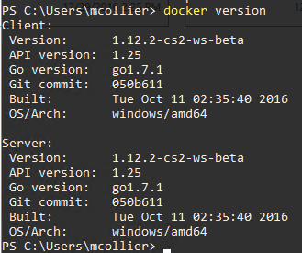
What? Where?
Docker
Supports Linux containers only
VirtualBox used to run small Linux kernel containing Docker server
Docker for Windows
Version 1.12 Beta 26 (at a minimum)
Recommended: 1.13.0-rc4
Windows Containers only in Beta channel at this time
Windows 10 Anniversary Edition
Runs . . .
Physical – either Windows Server or Hyper-V container
Windows 10 – only Hyper-V
Azure VM – isolation mode must be Windows Server, or “process”. Nested virtualization not yet supported.
Image: https://in.finance.yahoo.com/news/jet-isn-t-actually-cheaper-183200209.html
Notes:
http://extratv.com/2011/02/27/afis-100-years-100-movie-quote-1/
Which version of Docker to install?
What runs where?
Azure VM – isolation mode must be Windows Server, or “process”. Hyper-V not yet supported due to lack of nested virtualization capabilities.
Physical – either Windows Server or Hyper-V container
Windows 10 – only Hyper-V
Windows Server 2016 w/ Containers
Azure VM in Azure Marketplace
Docker 1.12.2-cs2-ws-beta

Slide 33
Getting Started with Docker
Notes:
Docker manages container images and instances, while Windows Server Containers/Hyper-V Containers host the Windows Container instances that Docker is managing. The Docker engine and client are required management tooling to deploy Windows Containers.

Slide 34
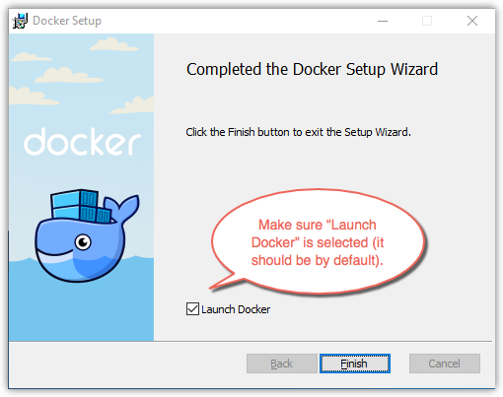
Disclaimer: Forget the GUI
Get comfortable with the command line!
(--help is your friend)
Content © Microsoft
Notes:
Image from: https://docs.docker.com/docker-for-windows/

Slide 35
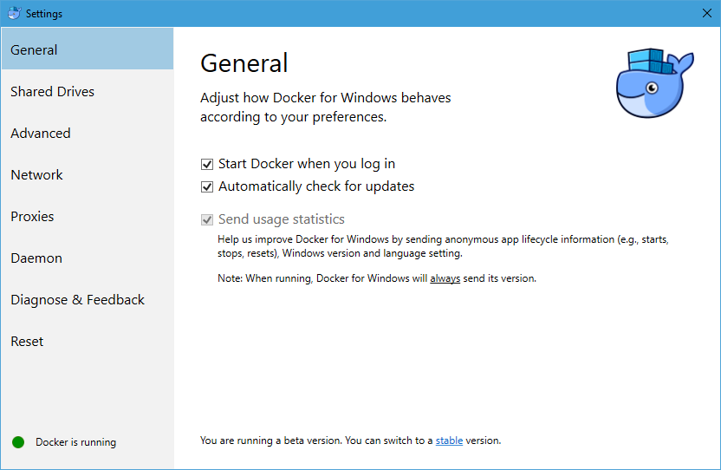
Forget the GUI . . . But . . . .
Docker for Windows
Not to be confused with “Docker”
Provides a GUI for very basic Docker settings (shared drives, network, proxies, Docker daemon, etc.)
Sets up Docker host OS/VM – “MobyLinuxVM”
Use Beta build
version 1.13.0-rc4
Same version as instructions at http://aka.ms/containers.
Switch between Windows and Linux
Still going to use docker command line!
Notes:
So . . . About that whole “Forge the GUI” thing . . . .
(If you want to use Windows containers on Windows 10 or Server 2016 you’ll need the Beta channel and the Windows 10 Anniversary Edition, if you want Linux containers you can choose either the Stable or Beta channel installers).
Docker for Windows sets up the ‘MobyLinuxVM’ for Linux Docker containers. We’ll show that in the demo soon.
Use the Beta-channel for Docker for Windows in order to get Windows Container support, including ability to switch between Windows and Linux containers.
Regardless . . . . Still going to use the docker command line tooling.

Slide 36
Installing Docker on Windows
Available Hosts
Windows Server 2016, Windows 10 Anniversary (not Home)
Add Features
Hyper-V & Containers
Install Docker Client and Server
http://aka.ms/containers
Isolation Modes
docker run --isolation=hyperv <image> (default on Win10)
docker run --isolation=process <image> (not supported on Win10)
Content © Microsoft
Notes:
Available Hosts:
Nano Server, Server Core, or Windows 10 Anniversary. Today we’re going to demo using Windows 10 and “Hyper-V containers. If you want to try using Server 2016, you can deploy images in Microsoft Azure or using a local VM.
On Windows 10, start by adding two new features, Hyper-V, and containers. You can do this via add/change features, or via PowerShell.
With that done, we next have to install the Docker client and deamon (service). I highly recommend (based on personal experience) that you closely follow the instructions for the host you plan to use as found at aka.ms/containers. This will save you some heartache and these instructions are continually updated with the latest changes. Something that’s VERY important while we’re still in preview and containers as well as the Docker bits for Windows are changing frequently.

Slide 37
Docker on Windows
Docker basics
Manage images
Notes:
Show Docker is installed via “docker version”

Slide 38
Building our own Images - Dockerfile
Method for automated container image creation
Consumed when running “docker build”
Enables automated builds via Docker Hub
Caches unchanged commands
Content © Microsoft
Notes:
Lets take a closer look at a Dockerfile as this is really the preferred method if you can’t pull an existing image from a registry.
#click (method for automated creation)
read
#click (consumed when running docker build)
It is consumed when we say “docker build”. The build process reads this file
#click (automated builds via docker hub)
It can also be used as part of automation. You can upload your dockerfile to the Docker hub, it will help perform automated, triggered builds. If an image (layer) that you’re dependent on changes, your image will also be updated. This includes a web hook that you can use to start any CI testing or even a redeployment of your image.
#click (cache unchanged commands)
Anything that’s unchanged, just gets cached and reused.

Slide 39
Building our own Images - Dockerfile
Method for automated container image creation
Consumed when running “docker build”
Enables automated builds via Docker hub
Caches unchanged commands
# The `FROM` instruction specifies the base image. You are
# extending the `microsoft/aspnet` image.
FROM microsoft/aspnet
# Next, this Dockerfile creates a directory for your application
RUN mkdir C:\helloaspnet
# configure the new site in IIS.
RUN powershell -NoProfile -Command \
Import-module IISAdministration; \
New-IISSite -Name "ASPNET" -PhysicalPath C:\helloaspnet -BindingInformation "*:8000:"
# This instruction tells the container to listen on port 8000.
EXPOSE 8000
# The final instruction copies the site you published earlier into the container.
ADD WebApplication2/bin/PublishOutput/ /helloaspnet
Each adds a layer; temporary container.
Group actionable items together to optimize for size.
Separate to optimize for speed (if items change - cached layers)
Content © Microsoft
Content © Microsoft
Notes:
Let’s take a look at a slightly more interesting Dockerfile example.
Uses multiple commands; some commands appended to each other to optimize size.

Slide 40


Building our own Images - Dockerfile
ADD
Layer 4
Method for automated container image creation
Consumed when running “docker build”
Enables automated builds via Docker hub
Caches unchanged commands
# The `FROM` instruction specifies the base image. You are
# extending the `microsoft/aspnet` image.
FROM microsoft/aspnet
# Next, this Dockerfile creates a directory for your application
RUN mkdir C:\helloaspnet
# configure the new site in IIS.
RUN powershell -NoProfile -Command \
Import-module IISAdministration; \
New-IISSite -Name "ASPNET" -PhysicalPath C:\helloaspnet -BindingInformation "*:8000:"
# This instruction tells the container to listen on port 8000.
EXPOSE 8000
# The final instruction copies the site you published earlier into the container.
ADD WebApplication2/bin/PublishOutput/ /helloaspnet
Each adds a layer; temporary container.
Group actionable items together to optimize for size.
Separate to optimize for speed (if items change - cached layers)
EXPOSE
Layer 3
RUN powershell
Sandbox
Layer 2
RUN mkdir
Sandbox
Layer 1
Container OS
Image
Content © Microsoft
Content © Microsoft
Notes:
Let’s take a look at a slightly more interesting Dockerfile example.
Uses multiple commands; some commands appended to each other to optimize size.

Slide 41

Docker Compose
Define and run multi-container Docker applications
Define app’s environment with a Dockerfile
Define services to make up the app in docker-compose.yml
docker-compose up
Database
Web App
Web API
Cache
Service

Slide 42
Docker Compose
Define and run multi-container Docker applications
Define app’s environment with a Dockerfile
Define services to make up the app in docker-compose.yml
docker-compose up
version: '2.1'
services:
db:
build:
context: ./db
dockerfile: Dockerfile
ports:
- "1433:1433"
helloworldweb:
image: helloworldweb
environment:
- CONNECTION_STRING="Server=db;Database=SampleDB01;User ID=sa;Password=…;Integrated Security=False"
build:
context: .
dockerfile: Dockerfile
depends_on:
- "db"

Slide 43
Docker on Windows
Manage containers
.NET Console App -> Windows Container
SQL Server in Windows Container
ASP.NET Web App -> Windows Docker
Docker Compose
Notes:
# run a container
docker run microsoft/dotnet-samples:latest
# list containers
docker ps
# list all containers (including those not running)
docker ps -a
# run an existing, stopped container (do from cmd prompt)
docker start -ia _______
# stop a running container
docker stop

Slide 44

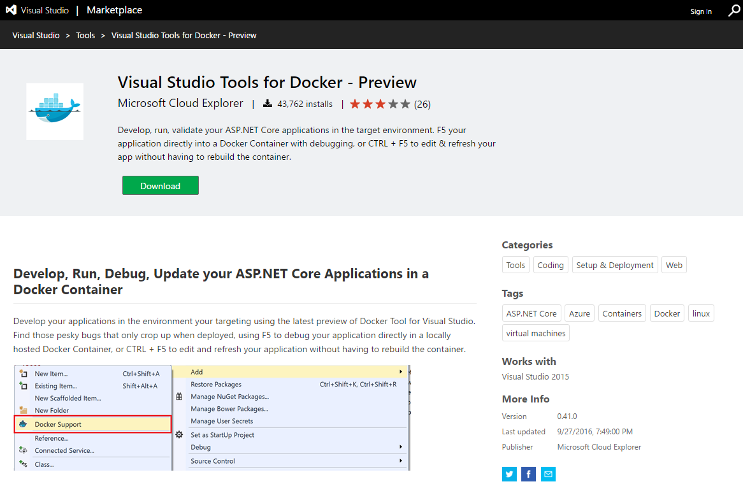
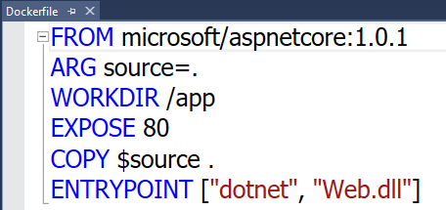
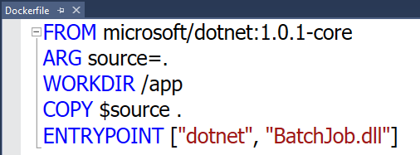
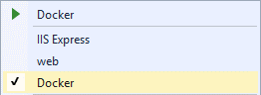
Visual Studio Docker Tools
Run, Debug, Test Web & Console apps in docker containers
Linux today, Windows Server & Nano Server coming soon
F5 Debugging
Edit & Refresh of code
Scaffolds docker assets
Dockerfile, docker-compose.yml
aka.ms/DockerToolsForVS | aka.ms/DockerToolsForVSCode
Notes:
aka.ms/DockerToolsForVSCode
OK: .NET Framework on Windows Containers
OK: .NET Core on Linux containers
Does not yet appear to work for .NET Core apps on Windows Containers.

Slide 45
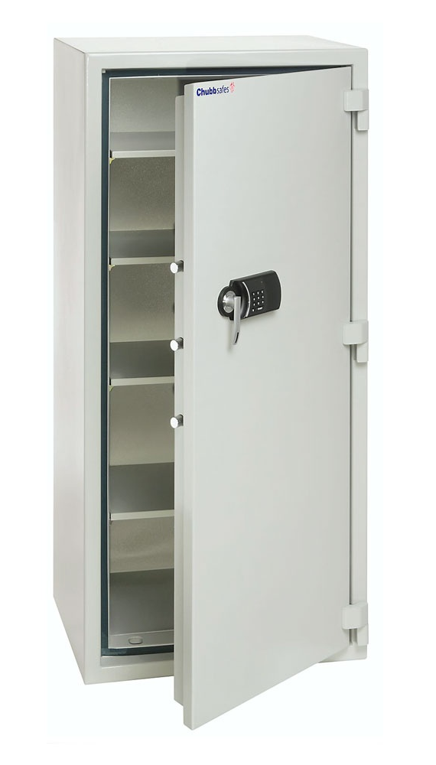
Private Image Repositories
hub.docker.com
Allows you to create public or private organizational repositories
Host your own
Requires Linux
https://docs.microsoft.com/en-us/azure/virtual-machines/virtual-machines-linux-docker-registry-in-blob-storage
Azure Container Registry
Avoid custom base images
Creates problems with sharing images (missing underlying layers)
Notes:
Image from: http://www.allaboutsafes.co.uk/fire-safes-c3/chubbsafes-office-385-e-fire-protection-office-safe-p301
What we’ve done here (hopefully) is create a local image on our workstation. The next step is to share this with others. And this requires a repository.
The Docker hub at oddly enough “hub.docker.com”, can be thought of as the highest authority in image repositories. It’s also the default location from which any “pull” command will pull its image. At the Docker hub you can host either public or private repositories. It’s really the “github” of Docker images.
You also have the option of hosting your own repository, say within your organizations network. This is a valid option but at least for today requires you to use Linux to host it.
One word of caution however, avoid creating your own custom base images using the same image names as publically available images. This will only cause problems and should be avoided at any cost. Doing so helps ensure that your images (dockerfiles) are not portable and prone to breaking if someone doesn’t have access to your specific image variation.

Slide 46
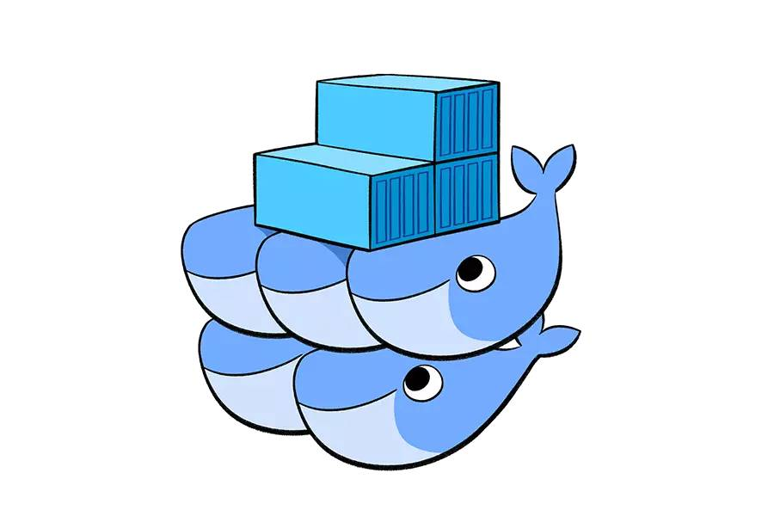
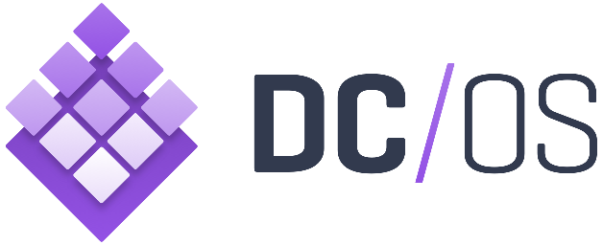
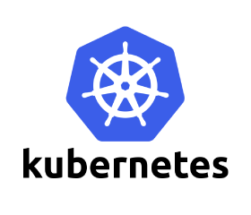

Orchestrations – multiple hosts
https://mesosphere.com/
https://www.docker.com/products/docker-swarm
http://kubernetes.io/
https://blogs.msdn.microsoft.com/azureservicefabric
Notes:
What we’ve looked at here is a couple containers running on one machine. Where containers really start to shine is when you have multiple hosts, working together to run your containers. To accomplish this, to operate at scale, you need some type of orchestrator. This is where solutions like what you see here come into play.
DC/OS, the “data center operating system” was recently released as open source by Mesophere.
Docker’s “swarm” is now part of the docker client/deamon process and no longer a separate solution.
And Kubernetes is a rising star in this space.
Service Fabric supports Windows Containers (not Hyper-V) starting in SDK v.2.4.145
Each of these could easily be a session onto themselves. So I’ll simply say that when you are ready to move beyond a single container you’re likely going to look at these and other solutions very closely so that you can find one that best meets your needs.

Slide 47

Azure Container Service
We are excited to announce a limited preview of Azure Container Service for Windows Server containers. To join the preview, please register here. We look forward to receiving your feedback!
Azure Container Service is designed for enterprises, ISVs and startups looking to put containers into production, quickly and simply. It combines Azure’s infrastructure with a choice of open source container orchestration technology: DC/OS or Docker Swarm. To provision your container service, you simply select the VM cluster size, DC/OS or Swarm, and the Azure region, and the container service handles everything else. This preview of Windows Server containers under the Azure Container Service currently only supports Docker Swarm as the orchestrator.
Azure is founded on maximum choice for all developers and ITPros. With this preview, we’re opening the Azure Container Service to Windows Server developers for the first time.
https://azure.microsoft.com/en-us/blog/windows-server-containers-using-docker-swarm-on-azure-container-service-private-preview/
Notes:
Now you may be thinking what does the cloud have to do with all this? He’s been talking about containers on Windows 10 and Windows Server?
Well, when the time comes to start taking advantage of orchestrations, you could certainly set up your own cluster and deploy them there. But why do that when you have a cloud alternative.
Microsoft recently announced a preview of Windows Containers in the Azure Container Service. The Container Service allows you to deploy and manage complex clusters of containers using popular orchestrators such as DC/OS and Swarm.
Image from: taken by brent while in seat 14a on a flight from Tampa to Minneapolis in July of 2016

Slide 48
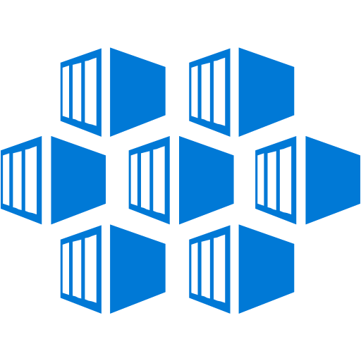




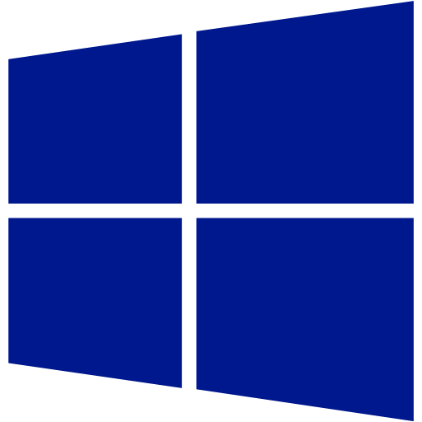
Dev/Test in “The Cloud”
Prod / Staging
Version Control & Builds
Docker Hub
Azure Container Registry
Azure Container Service
QA
Azure Container Service

Slide 49
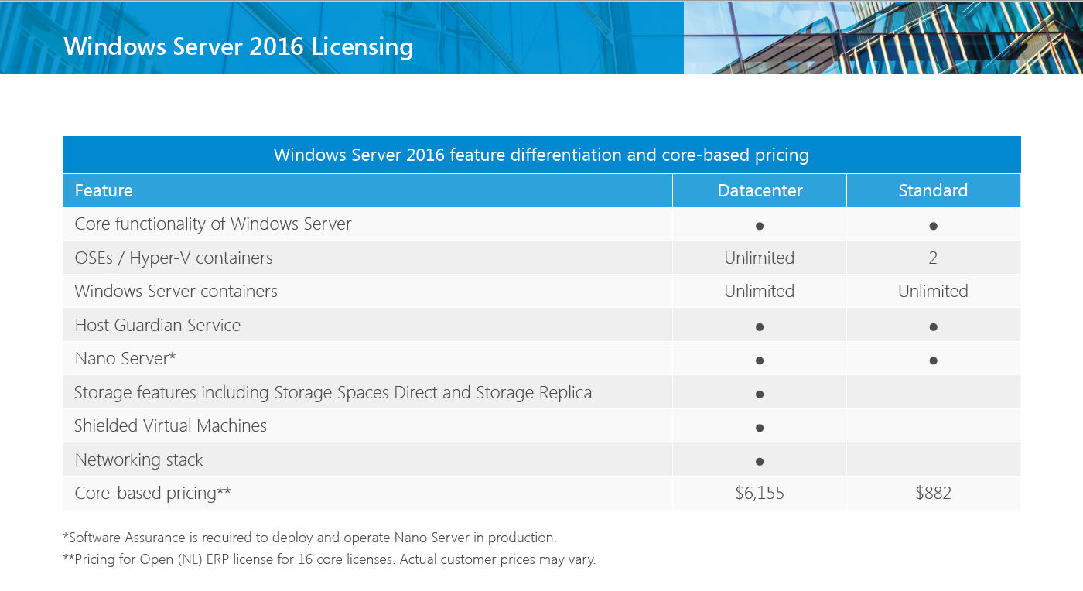
Licensing
https://www.microsoft.com/en-us/cloud-platform/windows-server-pricing

Slide 50
Getting Started
Learn by doing
Basic example from Docker Hub
Explore the Dockerfile
Seize the opportunity
Break down the monolith to microservices
Embrace DevOps benefits
No more “Works on My Machine”
It’s Fun!
Can’t really mess up
Containers at Microsoft
Microsoft and the container ecosystem
microsoft.com/containers
Windows Container Doc’s
Getting Started Guides and Documentation
aka.ms/windowscontainers
Community Links
Links to blogs, videos and other valuable resources.
aka.ms/windowscontainers/community

Slide 51
Resources
http://aka.ms/mike-containersforwindowsdevs
Azure Container Registry
https://docs.microsoft.com/en-us/azure/container-registry/container-registry-get-started-docker-cli
CI/CD with Docker, VSTS, GitHub, and ACS
https://blogs.msdn.microsoft.com/dmx/2016/12/28/vsts-loves-github-docker-azure-container-service-azure-container-registry-and-linux/
https://docs.microsoft.com/en-us/azure/container-service/container-service-setup-ci-cd
Docker for Windows
https://docs.docker.com/docker-for-windows/
Docker Command Line Reference
https://docs.docker.com/engine/reference/commandline/
Windows Container Samples
https://github.com/Microsoft/Virtualization-Documentation/tree/live/windows-container-samples
Getting Started with Docker
https://dzone.com/refcardz/getting-started-with-docker-1
Steve Lasker’s Blog
https://blogs.msdn.microsoft.com/stevelasker/
Image2Docker
https://blog.docker.com/2016/12/convert-asp-net-web-servers-docker-image2docker/

Slide 52
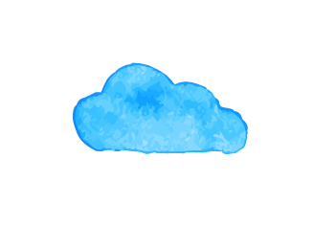
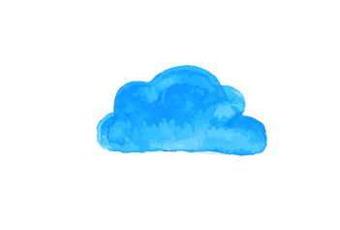
Advance your Azure Skills
Build your expertise and your career with training and certification!
Whether you’re new to Azure or already a cloud professional, training is one of the best investments you can make in your career. We’re offering a free online training option and great deals on certification.
Go to https://aka.ms/cmazure to get started today!

Slide 53
Questions?

Slide 54

Thank you!
https://aka.ms/brent-containersforwindowsdevs
Brent Stineman
DX/TED, Azure Specialist, Cloud Evangelist
Email: brestin@microsoft.com
Twitter: @brentcodemonkey
Web: http://brentdacodemonkey.wordpress.com
→
Creating quality bugs since 1992!
Notes:
Image Courtesy of Brent.
Purple dye all over his face is courtesy of his daughter

Slide 55

Thank You!
Michael S. Collier
@MichaelCollier | www.michaelscollier.com
michael.collier@microsoft.com
http://aka.ms/mike-containersforwindowsdevs

Slide 56
Active Directory Identity for Containers
Ready for Enterprise Applications
No infrastructure changes to Active Directory required
Leverages Group Managed Service Accounts
Enables containerized applications to authenticate with SQL Server, file shares, and more
Simple and Secure
Identity specified at container start time
Credentials are not stored within the container image
No changes required to move across environments i.e. dev, test, prod, cloud

Slide 57
Visual Studio 2017 Docker Tools
ASP.NET Web App in Docker
Docker Compose
Notes:
Show running ASP.NET Framework project with Windows container support.
Build dev and latest
Debug

Slide 58
Running our first Container/Image
Create and run a container from an image (first time)
docker run <image> (will pull image if not available locally)
List containers
docker ps –a (‘-a’ says to include stopped containers)
Run an existing container
docker start (-ia for interactive sessions, -a just for output)
Stop a running container
docker stop
Content © Microsoft
Notes:
Run dotnet sample: docker run microsoft/sample-dotnet:latest

Slide 59
Managing Containers
Remove an existing container
docker rm <container> (add a –f to remove ‘force’)
Remove all containers (use with caution)
docker ps –a -–format “{{.ID}}” | %{docker rm $_ -f}
Content © Microsoft

Slide 60
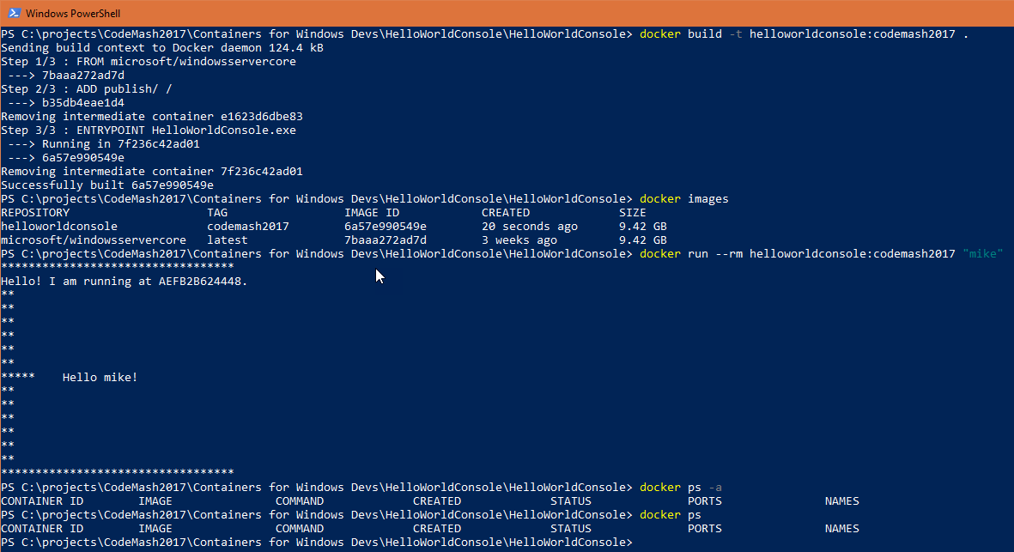
Notes:
Put screenshots here – backup option if stuff blows up
#
docker run microsoft/dotnet-samples:latest
# list containers
docker ps
# list all containers (including those not running)
docker ps -a
# run an existing, stopped container (do from cmd prompt)
docker start -ia
# stop a running container
docker stop

Slide 61
Putting it all together… The true power of choice

Slide 62
Build it and they will come
Cross your finders
Notes:
docker build clouddevelop2016 -t 'myimage:latest‘ .

Slide 63
Azure CLI 2.0 Preview
Switch to Linux container
docker run -v ${HOME}:/root -it --rm azuresdk/azure-cli-python:latest

Slide 64
Image: https://in.finance.yahoo.com/news/jet-isn-t-actually-cheaper-183200209.html

Slide 65
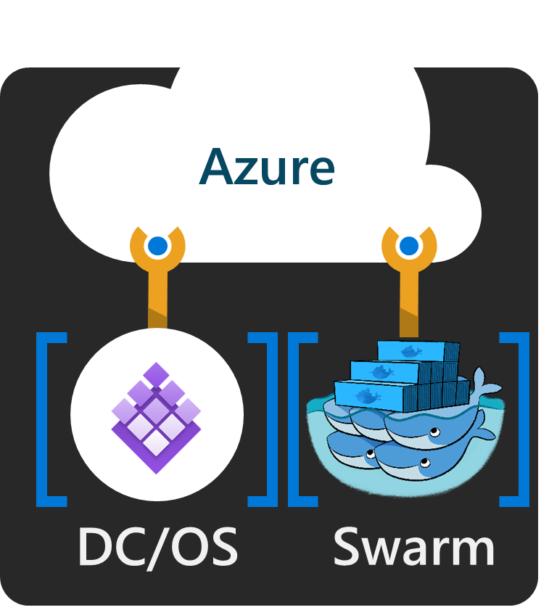
Azure Container Service
Orchestrate Containers on Azure Infrastructure
Standard Docker tooling and API support
Streamlined provisioning of DCOS and Docker Swarm
Linux and Windows Server containers
Azure and Azure Stack
Caution: Don’t think of ACS as a true “service”!
Notes:
Optimized open source tooling configuration for Azure
DC/OS – Marathon (orchestration)

Slide 66
ASP.NET MVC on Windows Containers / Docker
Notes:
Create ASP.NET MVC site
Dockerize it
Run it in Docker
Push to Docker Hub
Switch to VM
Pull image from Docker Hub
Run on VM

Slide 67



Every company is a software company

Slide 68




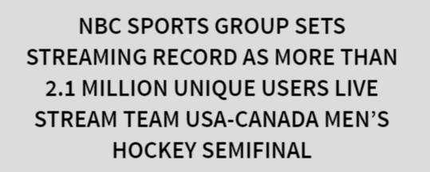
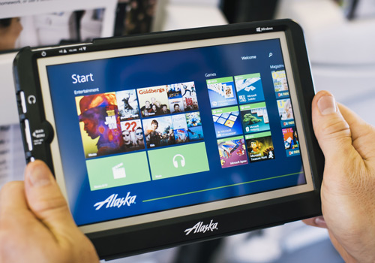
Every company is a software company

Slide 69
The cloud is changing expectations.
Notes:
If you’re developing solutions today, the cloud is changing your expectations.
Companies like Netflix, Uber, Skype, AirBnB, and many others are disrupting their respective industries. Even traditional companies like BMW, Ford, NBC, and Alaska Airlines are software companies today.

Slide 70
Operating System Deployment Modes
Clean up talking points.
Windows Server Containers
Container must match host
Server Core -> Server Core
Nano Server -> Nano Server
10.0.14300.1030 – 10.0.14393
10.0.14393 – 10.0.14393.206 *
Hyper-V Containers
Server Core or Nano Server
Host can be Nano Server, Windows Server Core, Windows Server w/Desktop, or Windows 10 Pro/Ent
Container
Container Host
Nested Virtual Machine
Container
Container Host
Virtual Machine Host
Physical Server
Physical Server
Content © Microsoft
Notes:
So a couple notes on the deployment model…
With Windows Server Container, the container must be matching the host. If I’m running a Nano Container, it must be running on a Nano Container Host. Server Core must be on Server Core. We’re working to relax this for the General Availability of Windows Server 2016, but at least through Technical Preview 5, this will be the case.
With Hyper-V containers, we currently only support Nano Server containers, at least through TP5. Server Core support will arrive by the time Server 2016 GA’s. However, the host can be anything we want… Nano Server, Server Core, or even Windows Server/Desktop. This is because the hyper-v container has its own, independent copy of the kernel.
Build number must match. Major.Minor.Build.Revision
If revision number is different, not technically blocked, but may not function properly under all circumstances and thus cannot be supported for production environments.

Slide 71
Dev env / Jenkins / container

Slide 72
Active Directory Identity for Containers

Slide 73
Windows Containers in AWS

Slide 74
EC2 Container Service

Slide 75
Messy manual script to install vs. infrastructure as code (picture?)

Slide 76
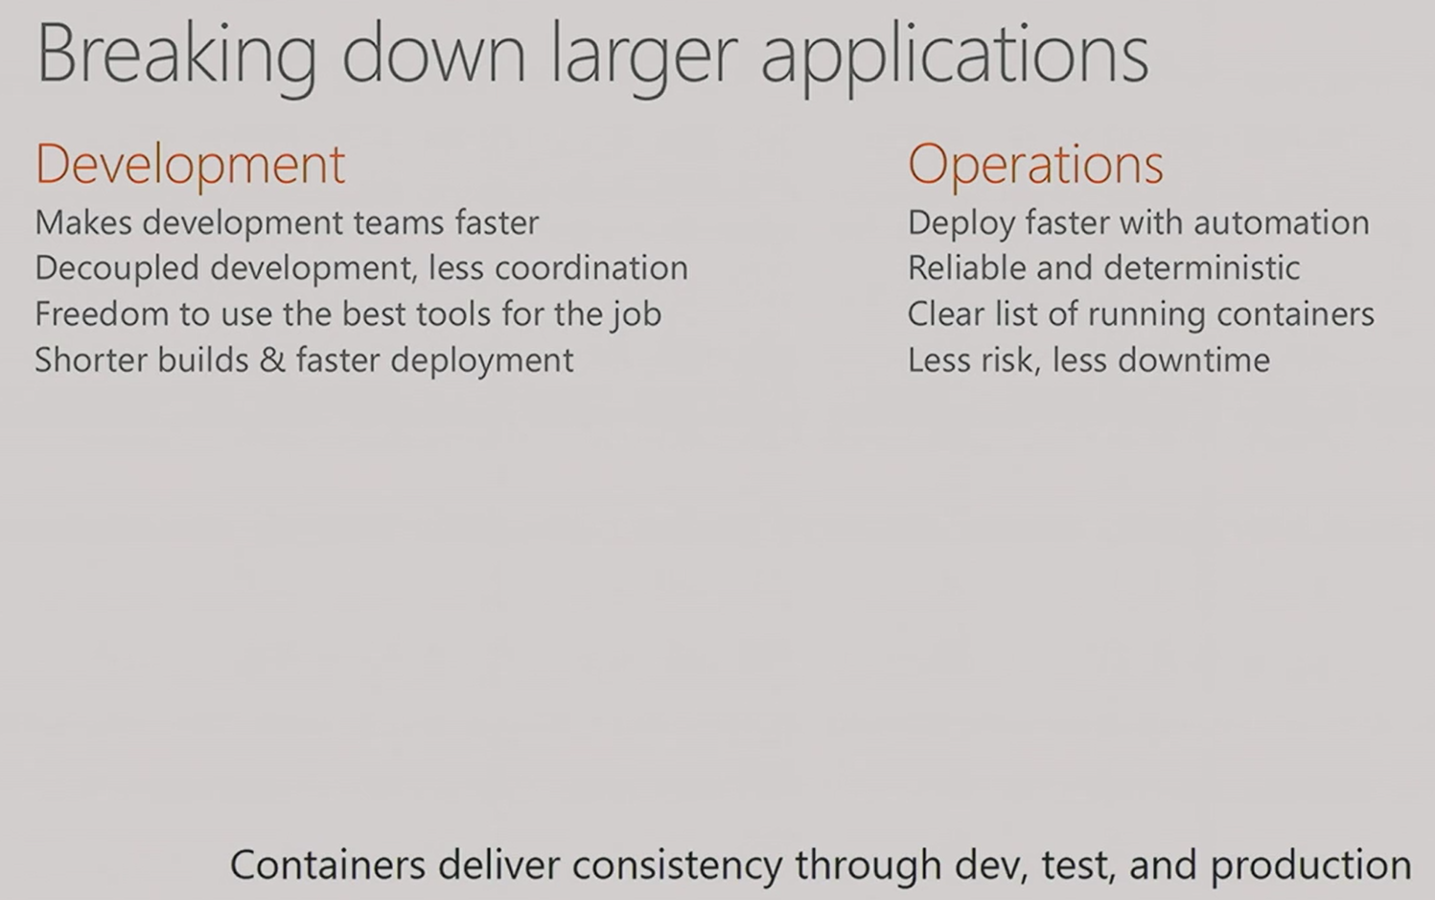
Consistency through Dev, Test, & Prod
?????

Slide 77
Picture of (messy) server farm?
Works on my machine picture?

Slide 78
Tell and Show
Enough talking, show me!
Notes:
But enough babble, do we want to actually see some Docker on windows?

Slide 79
Windows Containers in Azure

Slide 80
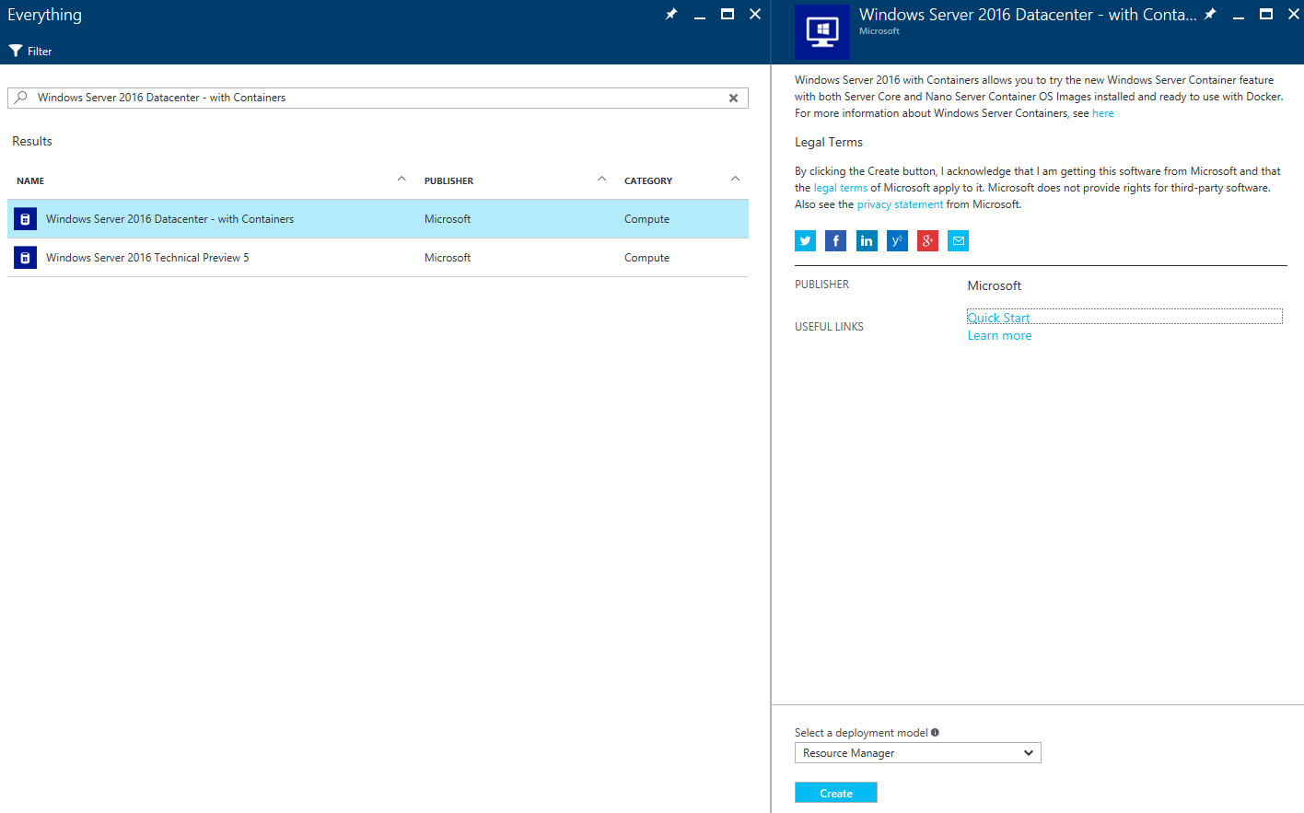
Create Azure VM

Slide 81
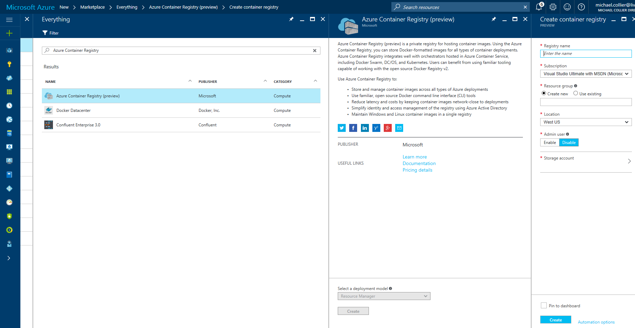
Azure Container Registry
az acr create -n myRegistry -g myResourceGroup -l southcentralus
Notes:
Azure AD control
Managed service
Images close to compute resources
Regions: East US, South Central US, West US

Slide 82
Azure Container Registry
Push and Pull
Notes:
Login to ACR registry via Docker CLI
Tag image
Push to ACR instance
Switch to Azure CLI 2.0 Preview in Docker container
Show images in private container

Slide 83

Azure Container Service
Orchestrate Containers on Azure Infrastructure
Standard Docker tooling and API support
Streamlined provisioning of DCOS and Docker Swarm
Linux and Windows Server containers
Azure and Azure Stack
Caution: Don’t think of ACS as a true “service”!
Notes:
Optimized open source tooling configuration for Azure
DC/OS – Marathon (orchestration)

Slide 84
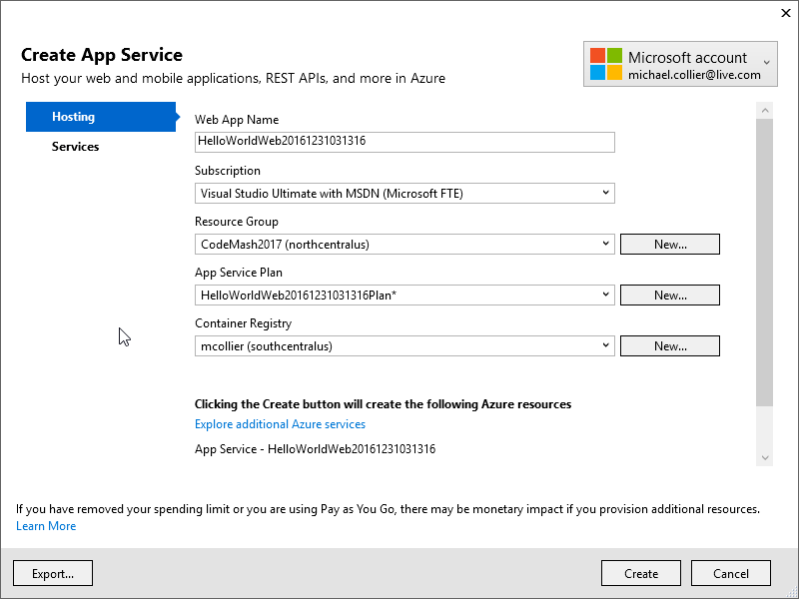
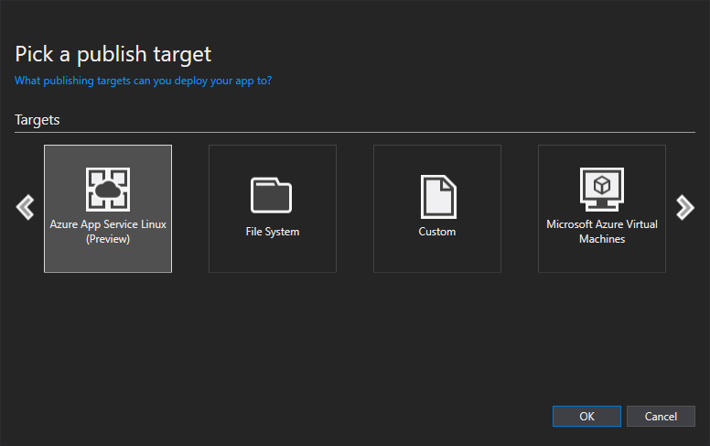
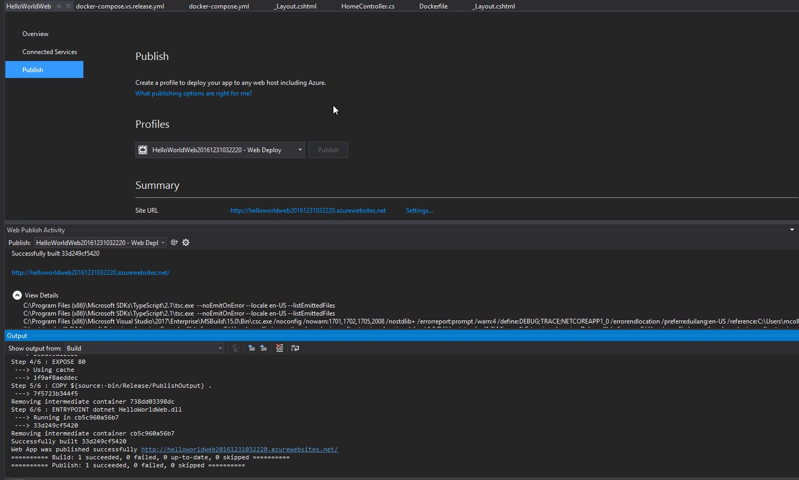
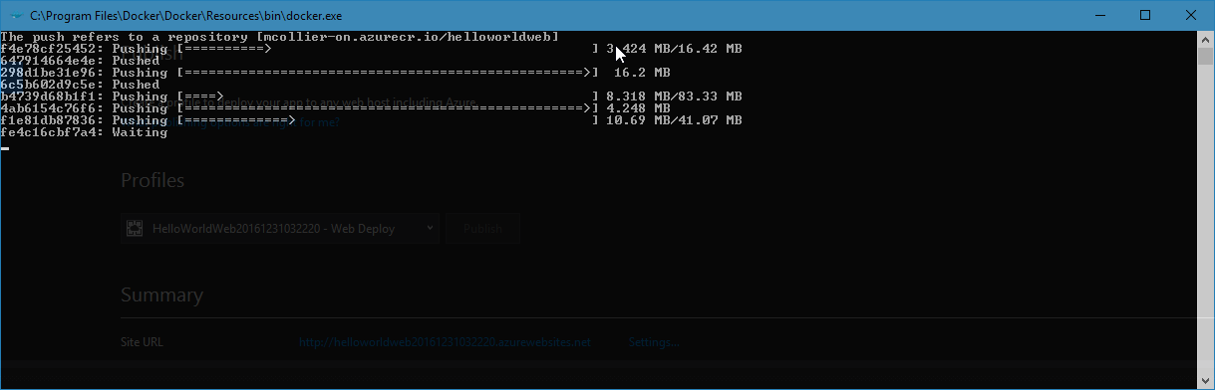
Azure App Service for Linux

Slide 85
Building our own Images - Dockerfile
FROM microsoft/windowsservercore
LABEL Description="IIS" Vendor="Microsoft" Version="10"
RUN powershell -Command Add-WindowsFeature Web-Server
CMD [ "ping", "localhost", "-t" ]
CMD
Sandbox
41 Kb
Layer 2
Web-Server
Sandbox
1.74 GB
Layer 1
Container OS
Image
7.68 GB
Source: https://github.com/Microsoft/Virtualization-Documentation/tree/live/windows-container-samples/iis
Content © Microsoft

Slide 86
Docker Architecture
Clients
Hosts
Registries
Docker Hub
repository 1
localhost
image 1
daemon
image 2
container 1
image 1
docker
container 2
image 2
repository 2
container 2a
image 3
image 4
remote host
Private Registry
daemon
repository 1
container 3
image 3
image 5
container 4
image 4
Image 6
container 5
image 5
Source: https://dzone.com/refcardz/getting-started-with-docker-1
Notes:
https://dzone.com/refcardz/getting-started-with-docker-1

Slide 87
History Lesson
Add more - http://www.structureconf.com/bryan-cantrills-wild-ride-through-the-history-of-the-container/
Started in Linux in 2003/2004
present, but not very usable
Docker made them popular starting June 2014
made easy to use, didn’t invent them
“Docker containers wrap a piece of software in a complete filesystem that contains everything needed to run: code, runtime, system tools, system libraries – anything that can be installed on a server. This guarantees that the software will always run the same, regardless of its environment.” – https://www.docker.com/what-docker
Notes:
Started in Linux in 2003/2004.
Linux Containers (LXC) are an operating-system-level virtualization method for running multiple isolated Linux systems (containers) on a single control host (LXC host). It does not provide a virtual machine, but rather provides a virtual environment that has its own CPU, memory, block I/O, network, etc. space and the resource control mechanism.
Became popular around 2013
Docker provides an additional layer of abstraction and automation of operating-system-level virtualization on Linux. Docker uses the resource isolation features of the Linux kernel such as cgroups and kernel namespaces, and a union-capable file system such as aufs and others to allow independent "containers" to run within a single Linux instance, avoiding the overhead of starting and maintaining virtual machines.
Image Source: http://www.freefoto.com/preview/13-73-32/Southampton-Container-Terminal

Slide 88
Containers Offer
Fast Iteration
~1 to ~3 seconds (Windows Server / Hyper-V)
Resource Controls
text
Rapid Deployment
Defined State Separation
Immutability
Text
Density
text
Shared kernel keeps disk pressure low
~1 minute for VM

Slide 89
Windows Containers
Container Host
System Processes
Session Manager
Container Management
Local Security Authority
Windows Server Container
Windows Server Container
Docker Engine
Event Manager…
System Processes
Application Processes
System Processes
Application Processes
Compute Services
Etc…
Windows Kernel
Content © Microsoft
Notes:
One of the things that kind of interesting is that we have a couple of container runtimes. We’ll start with Windows Server Containers. These are very similar to the Linux container model. We have our Windows Kernel…
#click (container host box)
And a container host which has…
#click (system processes)
Set of system processes that you’re likely to see on any windows server.
#click (container management)
And then we have container management. Our compute services which is our layer of containers in the operating system. And the Docker engine.
#click (Windows Server Container)
When we actually start a container, what we’re doing is starting up a new “user mode” and put copies of each of those system processes in.
#click (Application Processes)
And then the application process, whatever you put on the “docker run” line. If it was an IIS web server, it would have it own w3wp process. The reason for this model is that without these processes, we couldn’t have isolation between containers. You couldn’t make your own user name as it would be shared by the host. This way its specific to the container. Now you’d think this would be somewhat heavy with all these extra processes. But we’ve actually done a great deal of optimization around memory and startup time such that we can start up a Nano Server container in about 1.15 seconds right now and our goal is to get this down to a second by the time Windows Server 2016 ships later this year. We think this is a pretty amazing startup time. We also haven’t seen much memory overhead from these processes, and they give us that high degree of isolation folks expect from containers.
#click (second Server Container)
And of course we can have multiple of these containers running side by side. Each representing their own set of “user mode” processes. This is a fairly traditional container model, but being Microsoft, we really aren’t satisfied with being traditional. So we came up with another model.

Slide 90
Hyper-V Containers
Container Host
System Processes
Virtual Machine Specifically Optimized To Run a Container
Session Manager
Hyper-V Container
Container Management
Local Security Authority
Windows Server Container
Docker Engine
Guest Compute Service
Event Manager…
System Processes
Application Processes
Compute Services
Basic System Processes
Etc…
Windows Kernel
Windows Kernel
Hyper-V Hypervisor
Content © Microsoft
Notes:
Hyper-V containers differ from Server Containers in that they start with the Hyper-V HyperVisor.
#click (Container Host)
Then we add a container host.
#click (Windows Kernel)
This contains the Windows Kernel
#click (System Processes)
The same set of System processes
#click (container management)
And our compute services and docker engine. Much like we have with a Server Container Host.
#click (hyper-V Container)
But when we start a Hyper-V container, things starts to look different.
#click (Window Kernel)
The hyper-V container has its own copy of the Windows Kernel
#click (Basic System processes)
It has its own set of Basic System Process. This is a minimal set, just enough to launch
#click (Guest Compute Service)
The Guest Compute Service.
#click (Windows Server Container)
And a Windows Server Container.
#click (System Processes)
Which in turn then has its own set of System Processes
#click (Application Processes)
And application processes.
#click (Virtual Machine)
All this happens with a specially purposed Virtual Machine. This virtual machine has only one purpose in being, to run a container. We did this so that we get the same isolation boundaries that a traditional virtual machine has. If, unbelievably, someone were figure out some weird way to get outside of the container and mess with the kernel, they could crash themselves, but would be unable to hurt anyone else. This also means we have kernel independence, we could run different versions of the kernel. We could run the app on different versions of the operating system and all sorts of interesting things we’ll get into later.

Slide 91
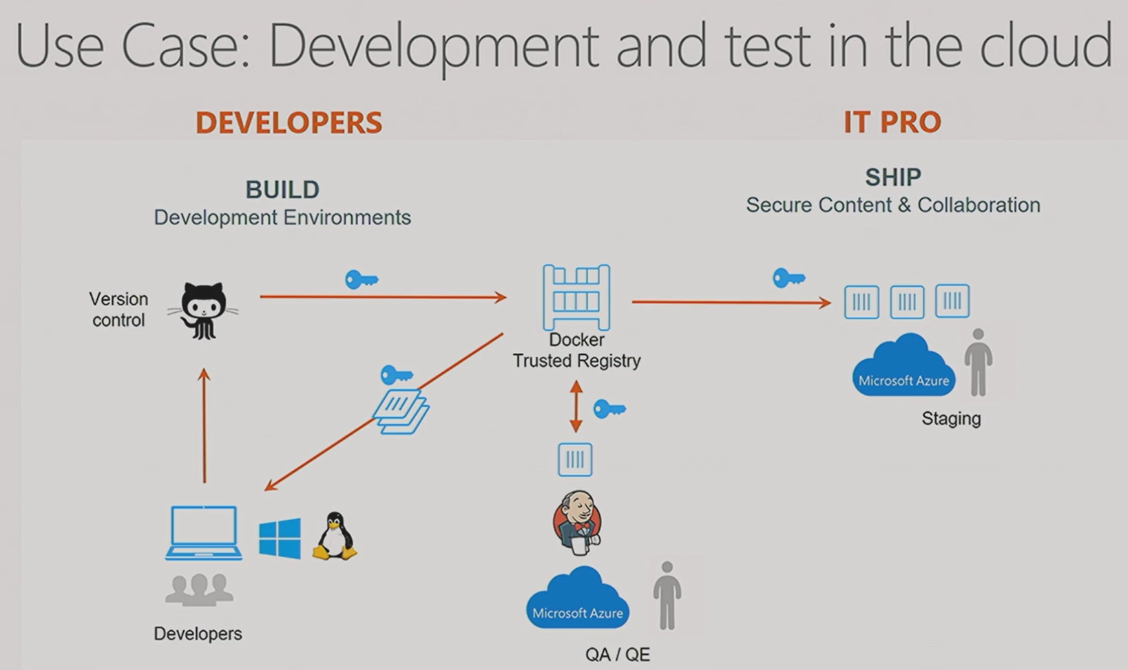
Development & Test in the Cloud
Make a version of this? Show VSTS too?

Slide 92
Azure Container Service
We are excited to announce a limited preview of Azure Container Service for Windows Server containers. To join the preview, please register here. We look forward to receiving your feedback!
Azure Container Service is designed for enterprises, ISVs and startups looking to put containers into production, quickly and simply. It combines Azure’s infrastructure with a choice of open source container orchestration technology: DC/OS or Docker Swarm. To provision your container service, you simply select the VM cluster size, DC/OS or Swarm, and the Azure region, and the container service handles everything else. This preview of Windows Server containers under the Azure Container Service currently only supports Docker Swarm as the orchestrator.
Azure is founded on maximum choice for all developers and ITPros. With this preview, we’re opening the Azure Container Service to Windows Server developers for the first time.
https://azure.microsoft.com/en-us/blog/windows-server-containers-using-docker-swarm-on-azure-container-service-private-preview/
Notes:
Now you may be thinking what does the cloud have to do with all this? He’s been talking about containers on Windows 10 and Windows Server?
Well, when the time comes to start taking advantage of orchestrations, you could certainly set up your own cluster and deploy them there. But why do that when you have a cloud alternative.
Microsoft recently announced a preview of Windows Containers in the Azure Container Service. The Container Service allows you to deploy and manage complex clusters of containers using popular orchestrators such as DC/OS and Swarm.
Image from: taken by brent while in seat 14a on a flight from Tampa to Minneapolis in July of 2016

Slide 93
Azure Container Service
Azure
Azure Container Service
Windows Containers in Preview
Azure Container Registry
Docker for Azure (Public Beta)
Windows Server 2016 with Containers
Azure App Service (Linux)
AWS
Docker for AWS (Public Beta)
EC2 Container Service (ECS) (Beta)
Windows Server 2016
We are excited to announce a limited preview of Azure Container Service for Windows Server containers. To join the preview, please register here. We look forward to receiving your feedback!
Azure Container Service is designed for enterprises, ISVs and startups looking to put containers into production, quickly and simply. It combines Azure’s infrastructure with a choice of open source container orchestration technology: DC/OS or Docker Swarm. To provision your container service, you simply select the VM cluster size, DC/OS or Swarm, and the Azure region, and the container service handles everything else. This preview of Windows Server containers under the Azure Container Service currently only supports Docker Swarm as the orchestrator.
Azure is founded on maximum choice for all developers and ITPros. With this preview, we’re opening the Azure Container Service to Windows Server developers for the first time.
https://azure.microsoft.com/en-us/blog/windows-server-containers-using-docker-swarm-on-azure-container-service-private-preview/
Notes:
Now you may be thinking what does the cloud have to do with all this? He’s been talking about containers on Windows 10 and Windows Server?
Well, when the time comes to start taking advantage of orchestrations, you could certainly set up your own cluster and deploy them there. But why do that when you have a cloud alternative.
Microsoft recently announced a preview of Windows Containers in the Azure Container Service. The Container Service allows you to deploy and manage complex clusters of containers using popular orchestrators such as DC/OS and Swarm.
Image from: taken by brent while in seat 14a on a flight from Tampa to Minneapolis in July of 2016

Slide 94
.NET Console App
Notes:
Dockerize it
Run it in Docker
Push to Docker Hub
Switch to VM
Pull image from Docker Hub
Run on VM

Slide 95
“Docker containers wrap a piece of software in a complete filesystem that contains everything needed to run: code, runtime, system tools, system libraries – anything that can be installed on a server. This guarantees that the software will always run the same, regardless of its environment.”
-- https://www.docker.com/what-docker

Slide 96
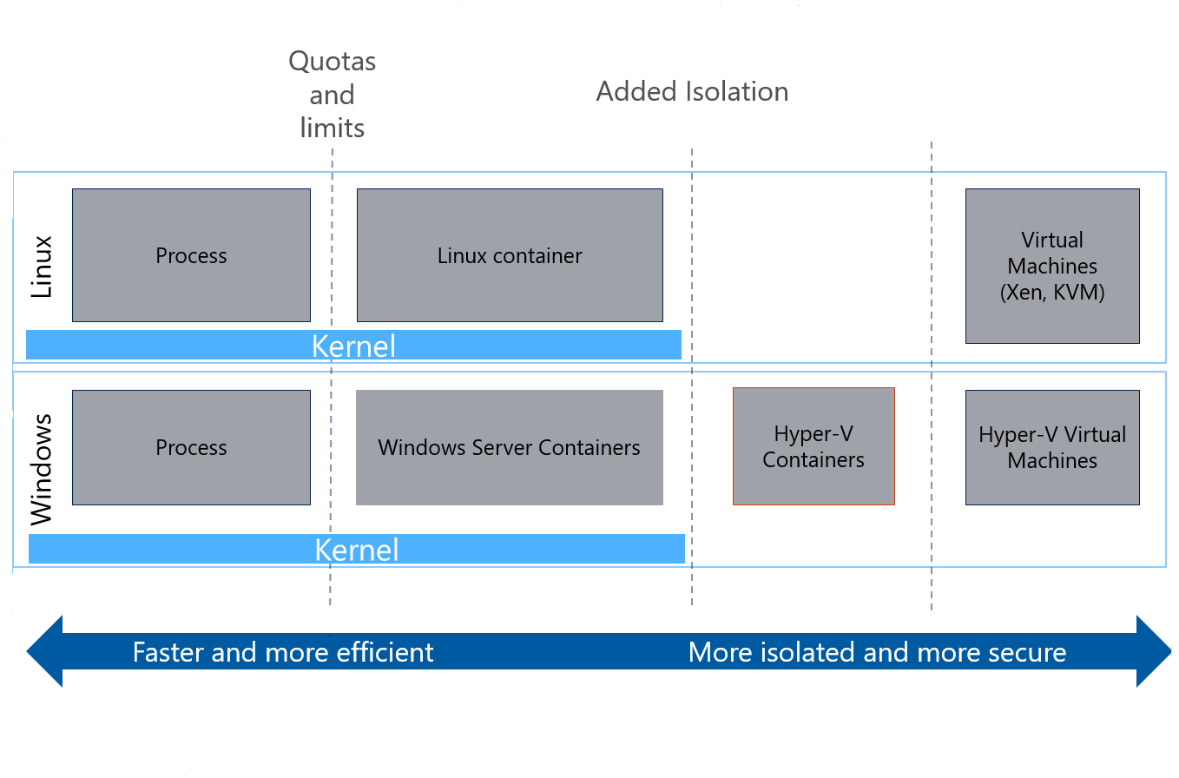
Virtualization & Isolation Levels
Image source: https://docs.microsoft.com/en-us/azure/service-fabric/service-fabric-containers-overview
Notes:
https://docs.microsoft.com/en-us/azure/service-fabric/service-fabric-containers-overview

Slide 97
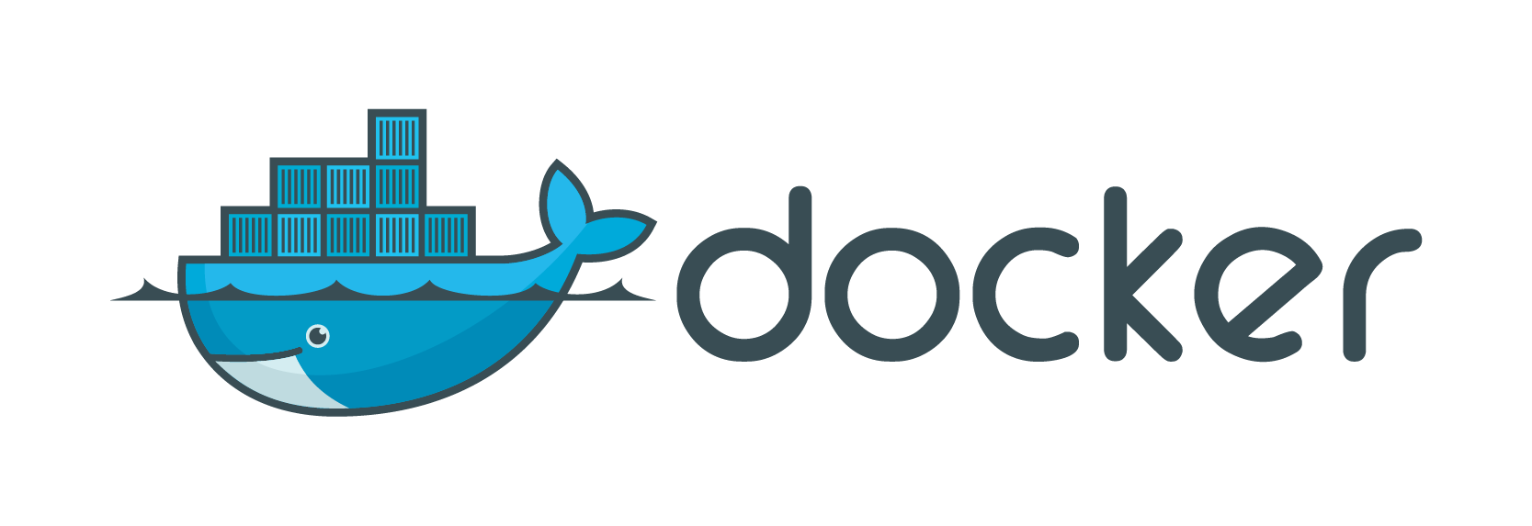
Docker & Windows Containers
manages
docker
Container(s)
Image(s)
Docker Engine (daemon)
Hyper-V Container
Windows Server Container
Windows Container
Windows Container
Notes:
Docker manages container images and instances, while Windows Server Containers/Hyper-V Containers host the Windows Container instances that Docker is managing. The Docker engine and client are required management tooling to deploy Windows Containers

Slide 98
The cloud is changing expectations.
Notes:
If you’re developing solutions today, the cloud is changing your expectations.
Companies like Netflix, Uber, Skype, AirBnB, and many others are disrupting their respective industries. Even traditional companies like BMW, Ford, NBC, and Alaska Airlines are software companies today.

Slide 99
What are app developers looking for?
Notes:
As you’re developing these innovate & disruptive solutions, what are app devs looking for?

Slide 100



The cloud is changing expectations.
Hyper-Scale
Availability
Agility
From start-up to enterprise
100% uptime
Deliver just-in-time speed
Move workloads across public/private clouds
Eliminate “works on my machine” issues
Reduction in MTTR
Cost reduction in maintaining existing applications
Increase frequency of software releases
Reduce developer ramp-up time
Notes:
Hyper-scale – From startup to enterprise
Availability – 100% uptime
Agility – Deliver just-in-time speed

Slide 101
Why Should You Care?

Slide 102


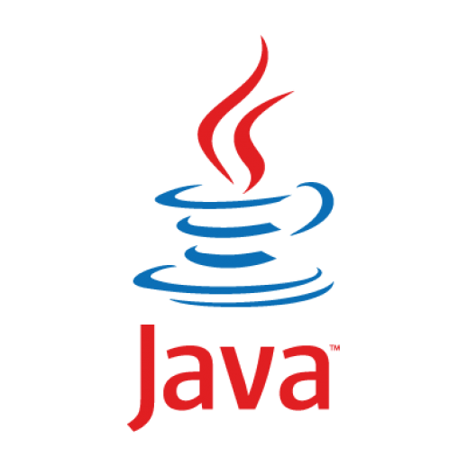
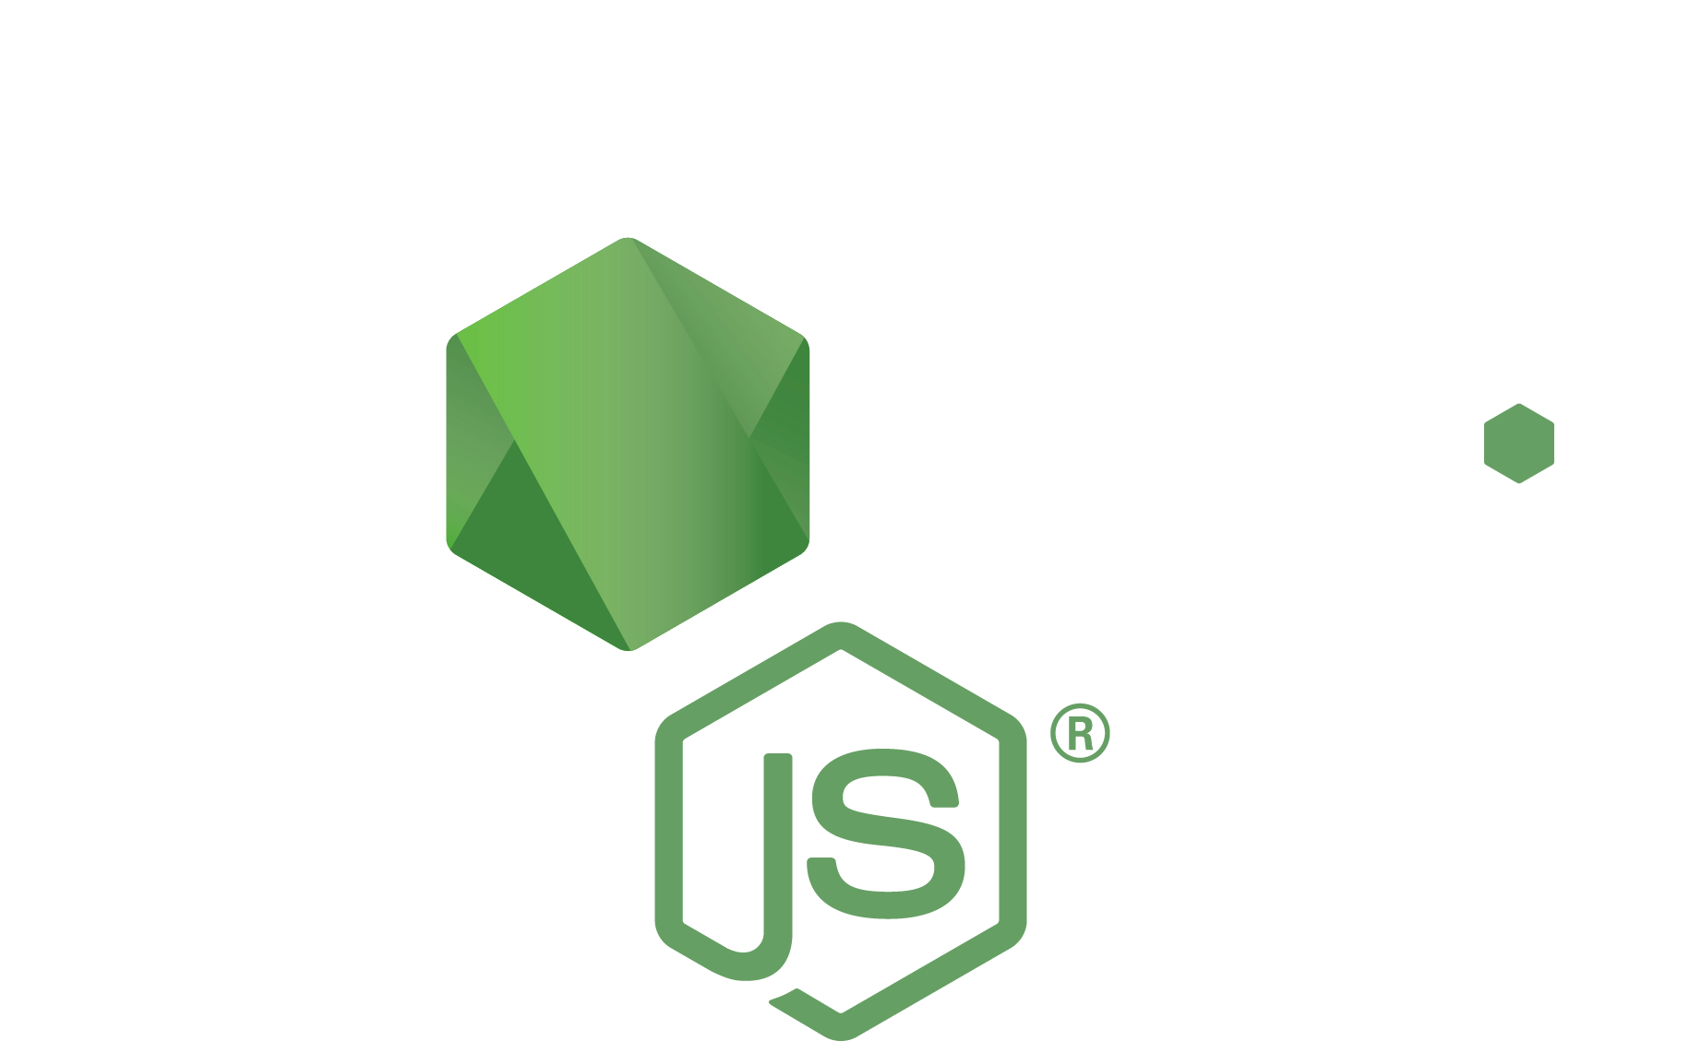
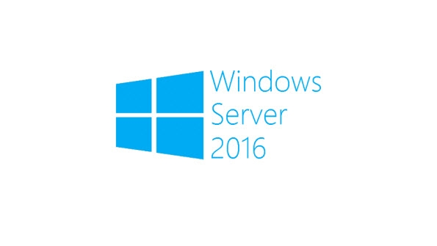
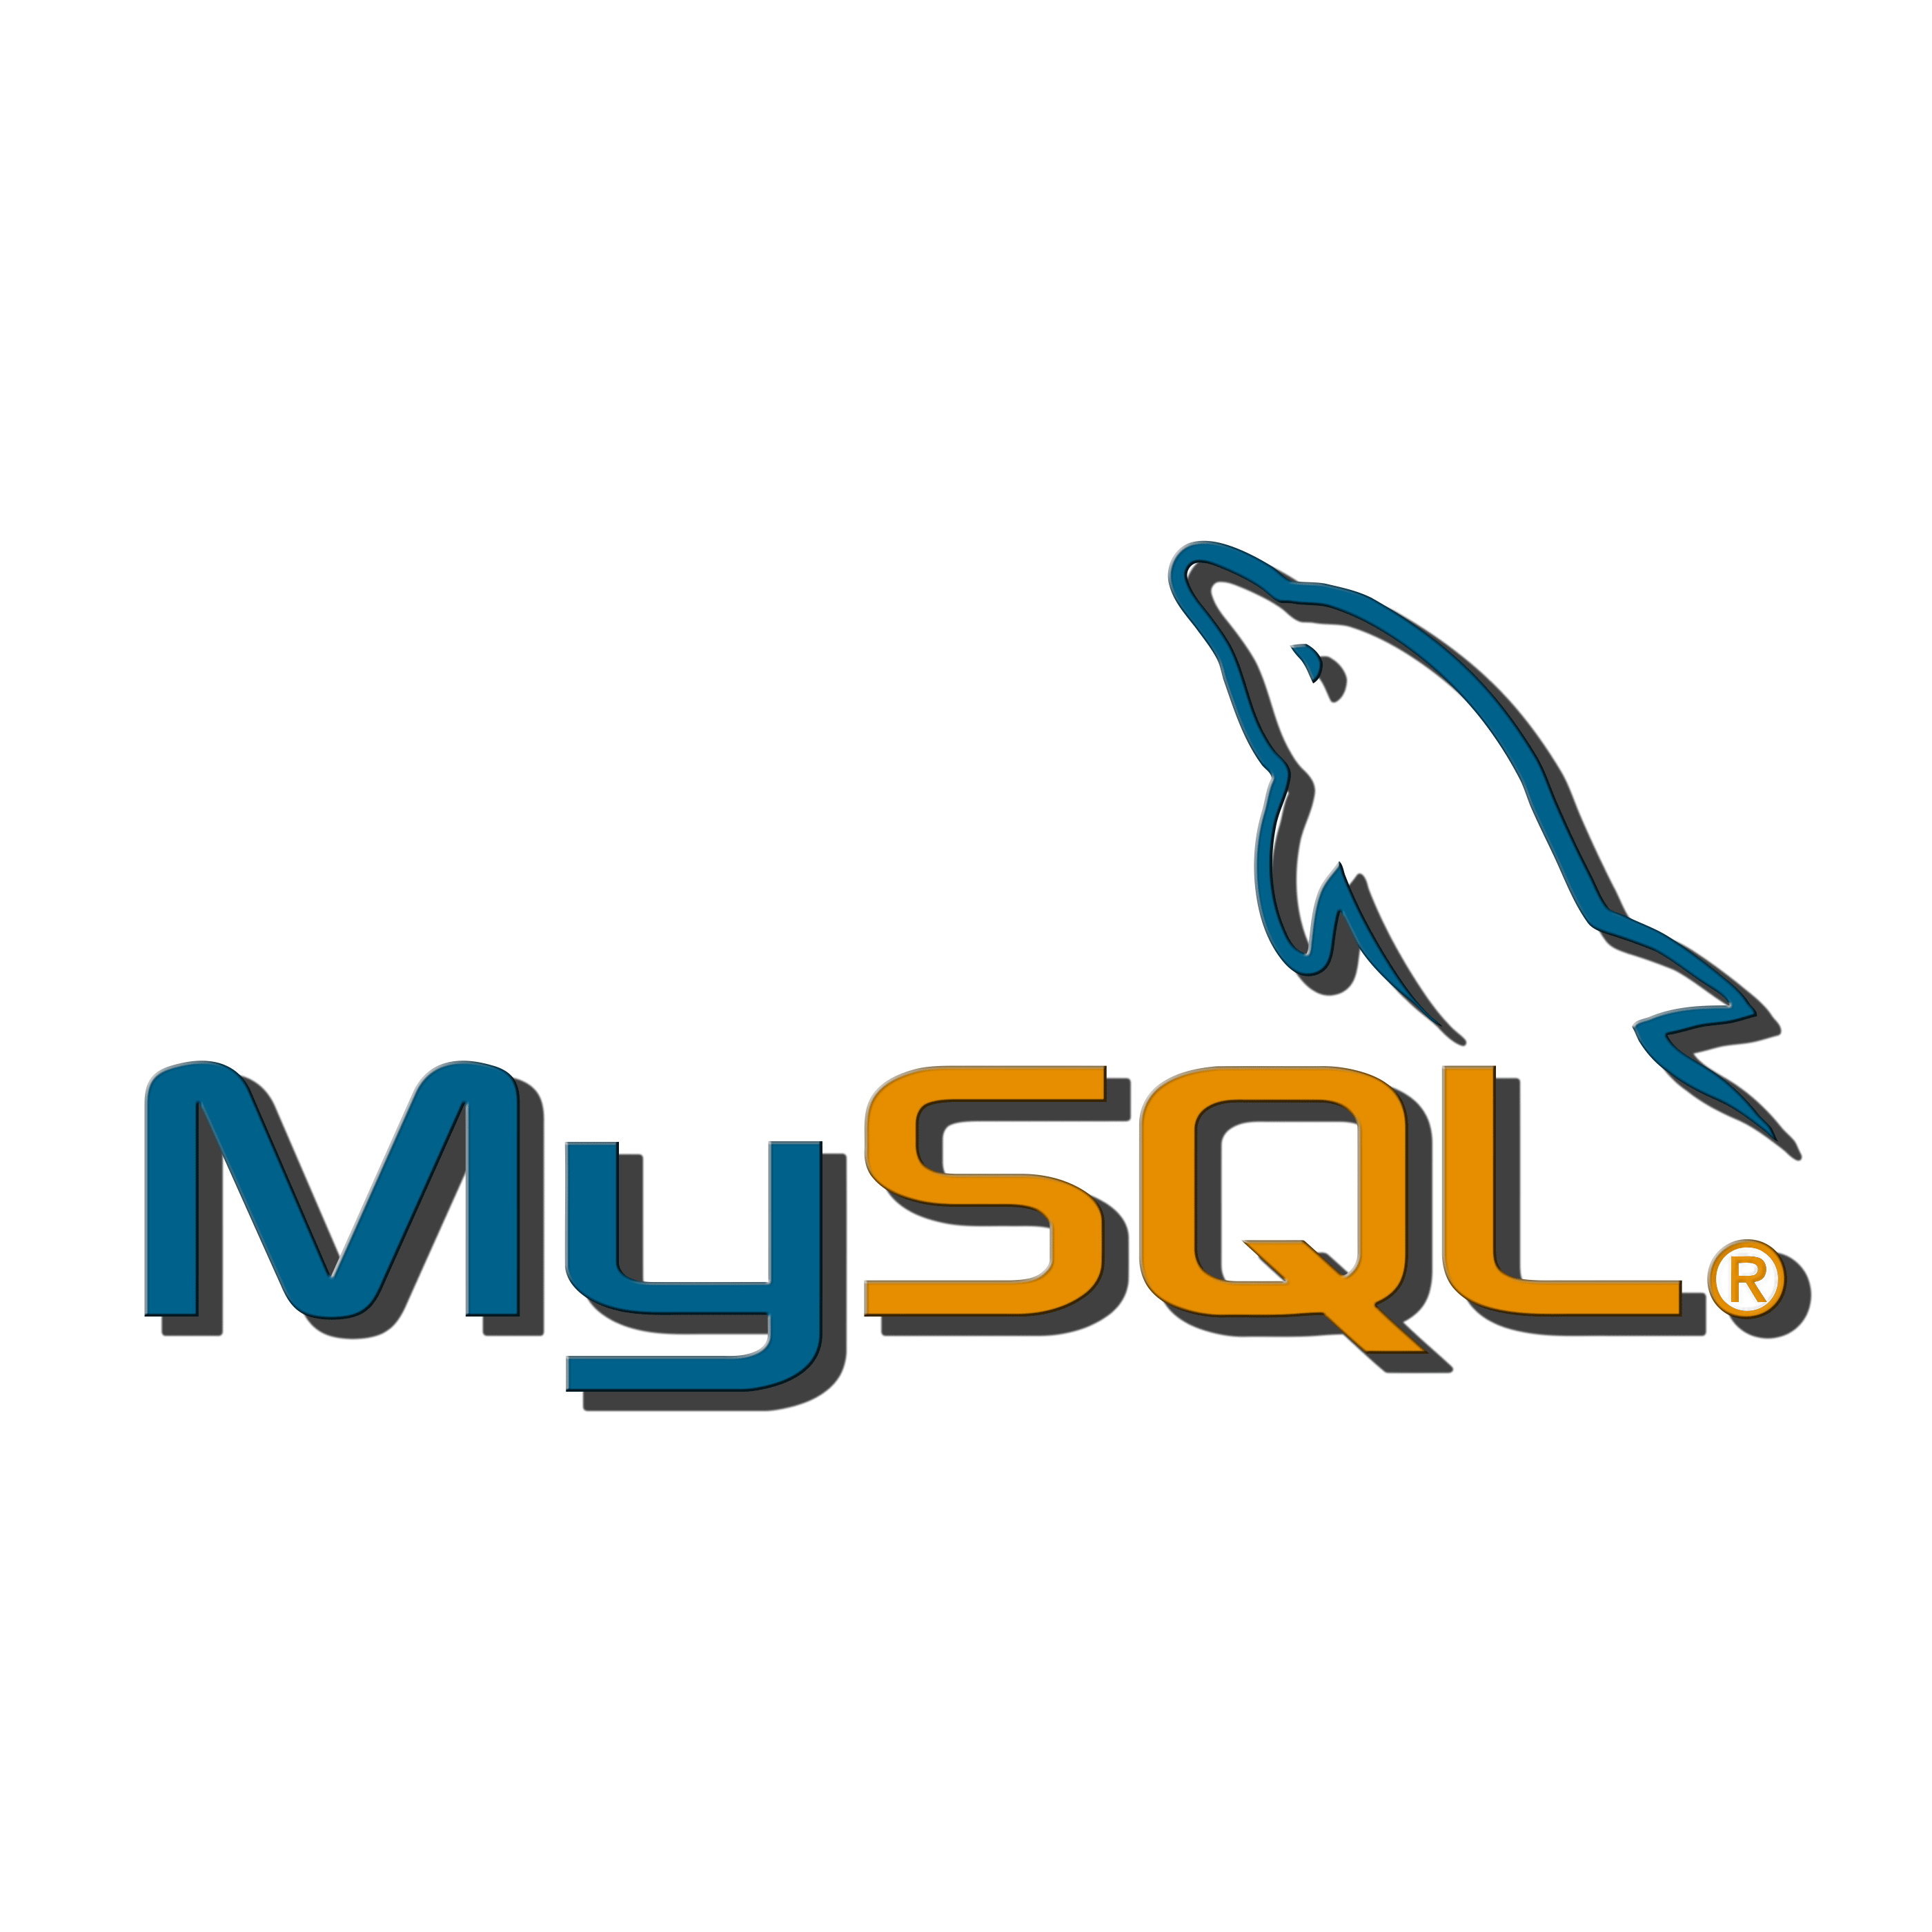
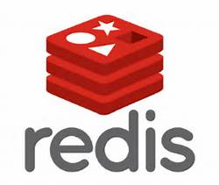



Easy experimentation
.NET Core

Slide 103

Easy & consistent dev environment setup
.NET Core

Slide 104
Containers Offer
Fast Iteration
Resource Controls
Rapid Deployment
Defined State Separation
Immutability
Density
Notes:
Fast iteration – far quicker to instantiate a container than a VM. For a Windows Server Core host, to spin up a NodeJS application running a Windows Server Container, startup is approximately 1 second, compared with approx. 3.3 seconds for a Hyper-V container. A VM can take about 5 seconds to over 1 minute!! Compare that to a Nano Server host, Windows Server Container comes in at under 600 ms and Hyper-V at 1.75 seconds, while a VM takes about 3 seconds.
Resource Controls – ability to limit CPU and memory to a specific container
Rapid Deployment – Since containers came be initialized so quickly, allows for on-demand compute. For example, AWS Lambda can spin up a new container when a method is invoked (or reuse a container). Containers enable the ability to spin up compute workloads very quickly, execute, and terminate.
Defined State Separation – Since containers are essentially read-only, any state is externalized (file system, external database, etc.)
Immutability – Docker images cannot be changed. Containers have a read/write layer applied. Changes committed to the running container (‘docker commit’) create a new image.
Density – consume less storage space, especially with Windows Server Containers in that they share the OS kernel. Additionally, containers offer the ability to pack more application/solutions into the available hardware, especially with combined with modern orchestration solutions.

Slide 105


Making Them Ideal For
Distributed Compute
Database *
Web
$$f\left(x\right)$$
Scale Out
Tasks
* Data should be saved to a volume mapped to the host. Data is closely tied to the lifetime of the container. Better for dev/test environments.
Notes:
Databases - Data should be saved to a volume mapped to the host. Data is closely tied to the lifetime of the container. Better for dev/test environments where there is a benefit to quickly setting up the database (engine, schema, data, security, etc.), and also a quick teardown.

Slide 106
Managing Images
Listing our local (on host) images
docker images
hub.docker.com
VERSION! VERSION! VERSION!
Pulling images
docker pull <image>
Removing images
docker rm <imageId>
Show history
docker history <imageId>
Tag images
docker tag <image> <username>/<image>:<version>
Content © Microsoft
Notes:
Assuming that all goes smoothly, we can start to work with Docker.
The Docker syntax is fairly straight forward. We start with “docker” (the executable we’re call, followed by a noun or verb for what we want to work with. We’ll start with getting a list of the images we have locally, and for that we’ll need a PowerShell of command prompt running with elevated permissions. Since I can’t type, I’ve prepared a PowerShell script that has many of the commands we’ll be using so I’ve already opened it in an elevated PowerShell ISE window.
List – talk about the key columns show.

Slide 107
Docker on Windows
Manage images
Notes:
# list images in local repository
docker images
# get a docker image from docker hub
docker pull microsoft/dotnet:nanoserver-runtime
# remove a local image
docker rmi

Slide 108
Building our own Images - Dockerfile
FROM microsoft/windowsservercore
RUN dism /online /enable-feature /all /featurename:iis-webserver /NoRestart
RUN echo "Hello World - Dockerfile" > c:\inetpub\wwwroot\index.html
CMD [ "cmd" ]
CMD
Layer 3
echo “Hello ..”
Sandbox
PS C:\> docker history iis-sample1
IMAGE CREATED CREATED BY SIZE
650e08a9c2d4 25 seconds ago cmd /S /C #(nop) CMD ["cmd"] 266 MB
379bd603bf53 27 seconds ago cmd /S /C echo "Hello World - Dockerfile" ... 1.74 GB
249081ecf5ee About a minute ago cmd /S /C dism /online /enable-feature /al... 7.68 GB
Layer 2
iis-websever
Sandbox
Layer 1
Container OS
Image
Content © Microsoft
Source: https://github.com/Microsoft/Virtualization-Documentation/tree/live/windows-container-samples/iis
More info at https://docs.microsoft.com/en-us/virtualization/windowscontainers/manage-docker/optimize-windows-dockerfile

Slide 109
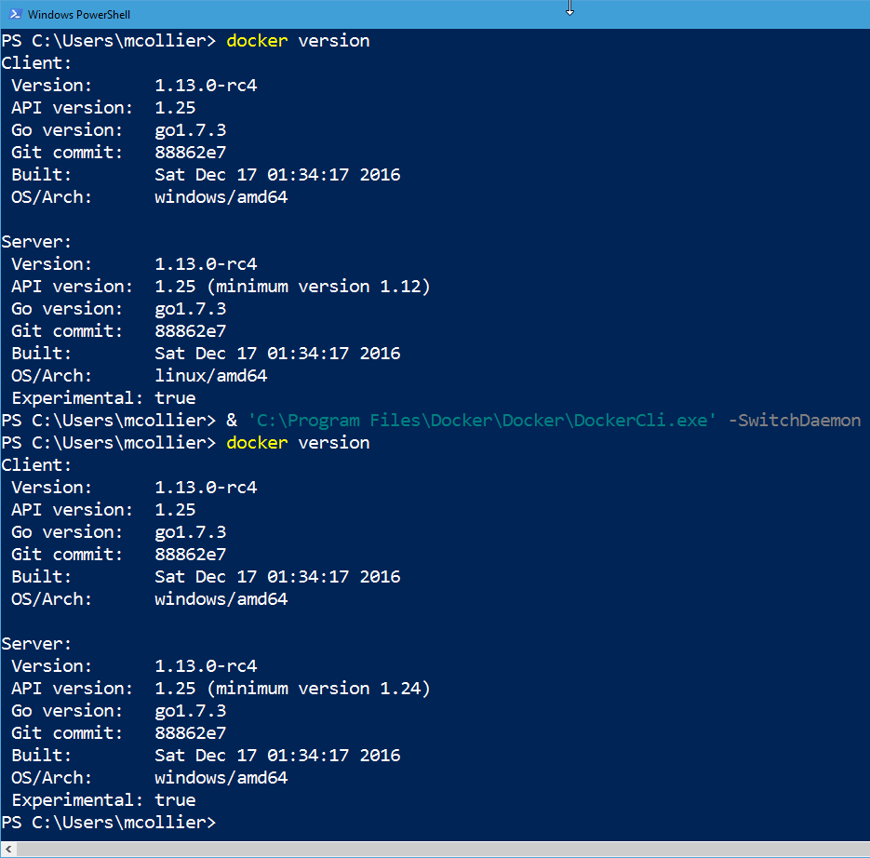
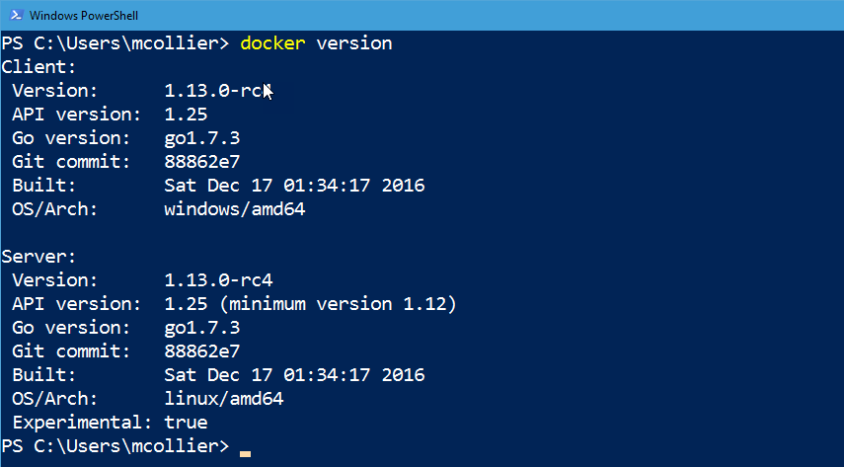

Slide 110
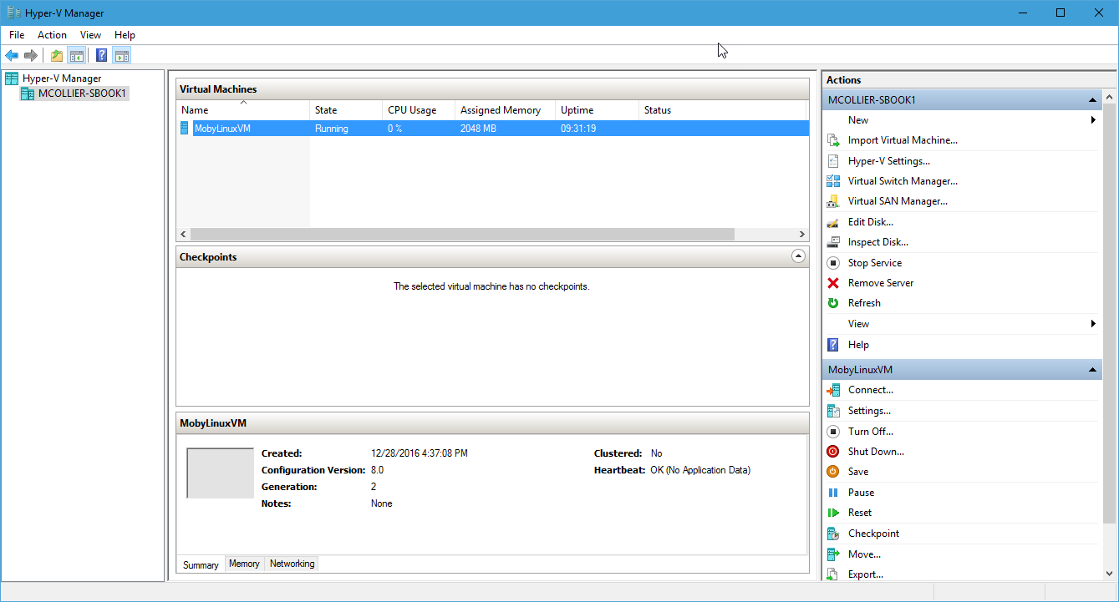

Slide 111
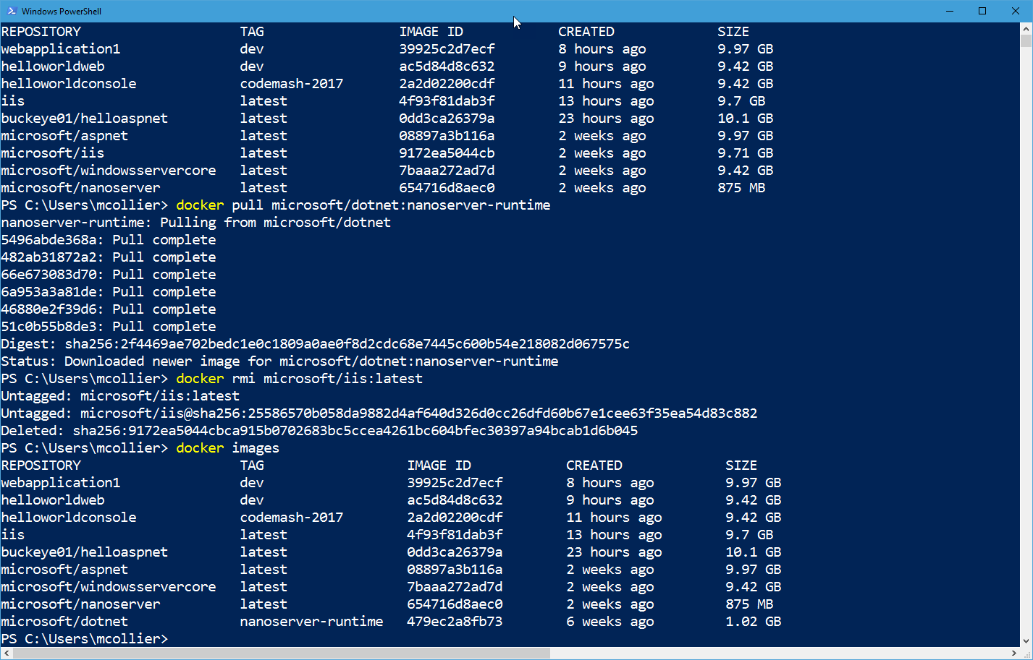
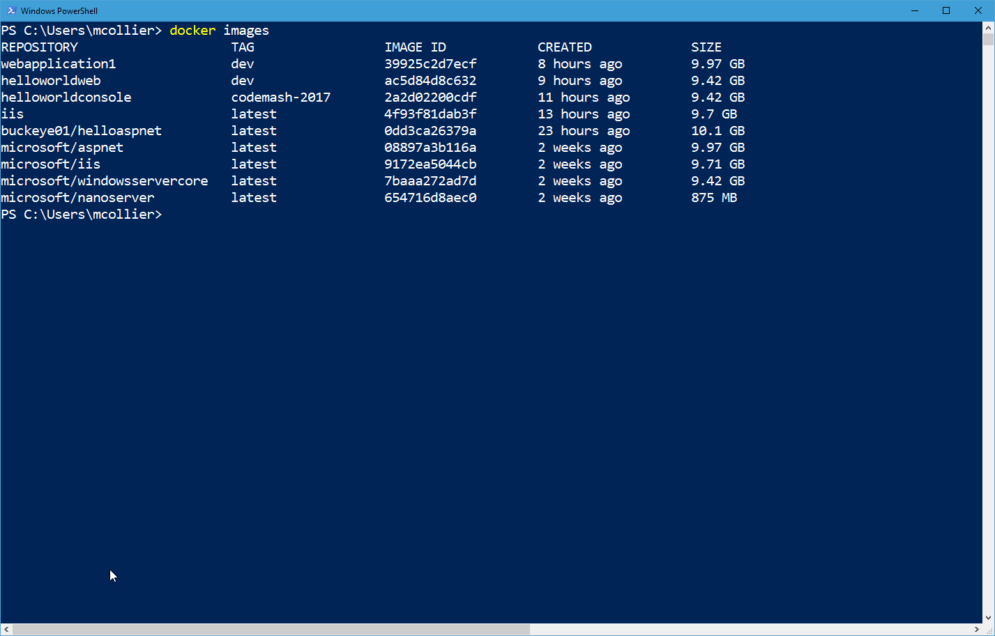
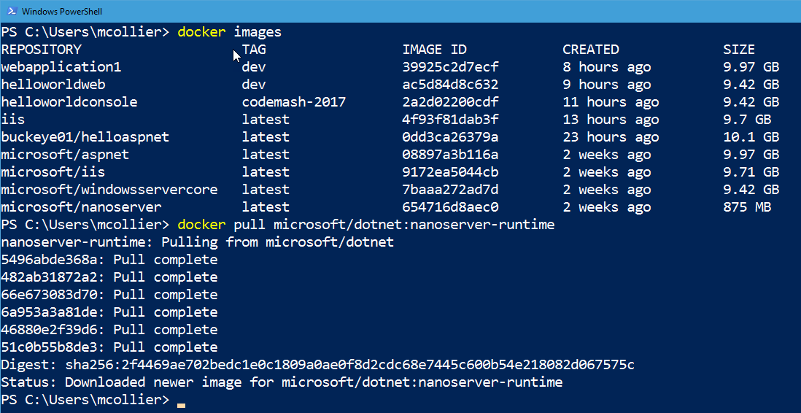
Notes:
Put screenshots here – backup option if stuff blows up

Slide 112
Development & Test in the Cloud
Make a version of this? Show VSTS too?

